Slide 1

“Vertov shows machinery and factories and intuits that this is what cinema is: the mass production and consumption of image.”

Slide 2
“Mechanical reproduction of art changes the reaction of the masses toward
art. The reactionary attitude toward a Picasso painting changes into the
progressive reaction toward a Chaplin movie. The progressive reaction is
characterized by the direct, intimate fusion of visual and emotional enjoyment
with the orientation of the expert. Such fusion is of great social significance.
The greater the decrease in the social significance of an art form, the sharper the
distinction between criticism and enjoyment by the public. The conventional is
uncritically enjoyed, and the truly new is criticized with aversion. With regard
to the screen, the critical and the receptive attitudes of the public coincide.”
Walter Benjamin, “Work of Art in the Age of Mechanical Reproduction.”

Slide 3
“This film is an experiment in cinematic communication of real events without the help of subtitles, without the help of a story, without the help of theatre. This experimental work aims at creating a truly international language of cinema, based on its absolute separation from the language of theatre and literature.”
This is the introductory caption to the film “Man with a Movie Camera.” What do you think this means? How do you think the language of cinema would be different from the language of theatre or literature?

Slide 4
Discussion Questions:
What themes or subjects are emphasized in the film? Why do you think they are emphasized?
What is the relationship between humans and technology in the film? Identify a scene that illustrates this relationship and be prepared to share with the class.
How do you think the soundtrack influences your experience of the film? How might a different soundtrack lead to a different experience of the film?
What are the values that you see reflected in the society portrayed in “Man with a Movie Camera”? Is there any sort of judgement about society made in the film?
What do you you think the film is suggesting about perception in the age of film? What scene or scenes shows this to you?

Slide 5
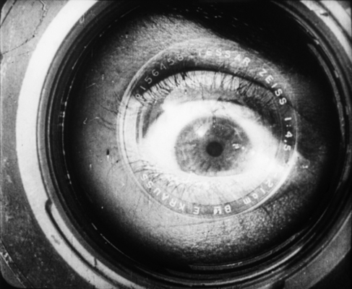
With your group, watch the section of “Man with a Movie Camera” assigned to you. Discuss what you think it is suggesting. Pay attention to the subject matter, how the shots are composed (mise-en-scene) and how one scene follows another (montage). Be ready to introduce your scene when we watch it with the class.
Group 1 - 11:30-12:00
Group 2 - 17:14-17-25
Group 3 - 18:30-19:00
Group 4 - 43:30-45:00
Group 5 - 1:03:40-End

