Slide 1
Surrealism (1924-1940s)

Slide 2
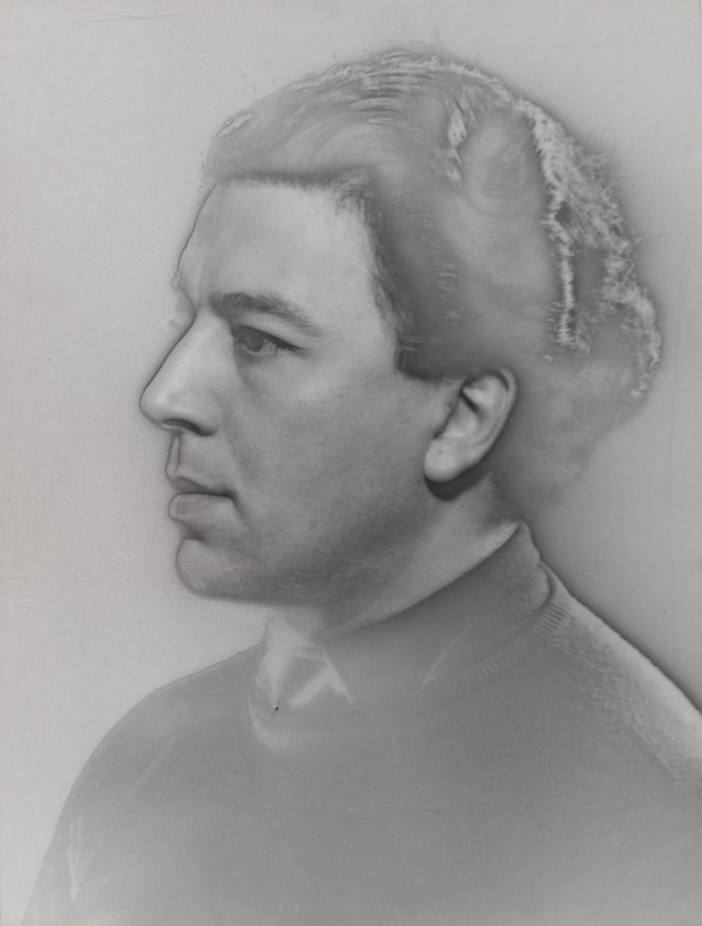
Man Ray. André Breton. 1931
MoMA Surrealism Theme
Notes:
Share this information with your students:
Led by poet André Breton, Surrealism began in Paris in 1924, and was active through World War II. Influenced by Sigmund Freud’s writings on psychology, this literary, intellectual, and artistic movement was interested in how the irrational unconscious mind could move beyond the constraints of the rational world.
Breton’s critics often referred to him sarcastically as the “Pope” of Surrealism. He had a strong hold on the group and those who disagreed with his views were often pushed out of the inner circle.
Man Ray. André Breton. 1931
Gelatin silver print (solarized)
11 1/2 x 8 3/4" (29.2 x 22.3 cm)
Gift of James Thrall Soby
© 2011 Man Ray Trust / Artists Rights Society (ARS), New York / ADAGP, Paris
92.1941

Slide 3
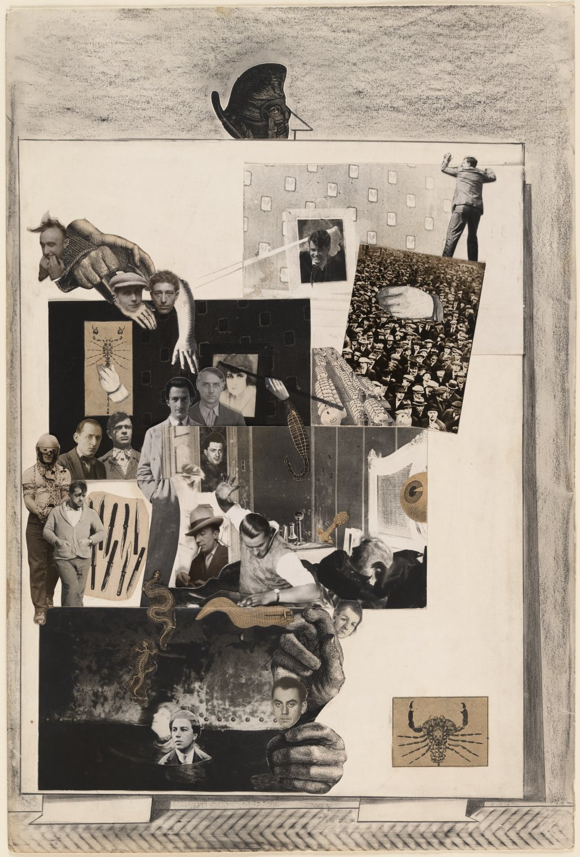
Max Ernst. Loplop Introduces Members of the Surrealist Group. 1931
MoMA Surrealism Theme
Notes:
Share this information with your students:
Loplop is the name of artist Max Ernst’s alter ego, a birdlike character featured in many prints, collages and paintings by artist Max Ernst. Loplop first appeared in Ernst's collage novels in the role of a narrator and commentator. In this collage, Ernst introduces a number of artists in the Surrealist circle, including leader André Breton, Man Ray, Salvador Dalí, Marcel Duchamp and others.
Max Ernst. Loplop Introduces Members of the Surrealist Group. 1931. Cut-and-pasted gelatin silver prints, cut-and-pasted printed paper, pencil, and pencil frottage
on paper, 19 3/4 x 13 1/4" (50.1 x 33.6 cm). Purchase.
© 2011 Artists Rights Society (ARS), New York / ADAGP, Paris
267.1935

Slide 4
Tapping into the Unconscious: Automatism and Dreams
MoMA Surrealism Theme

Slide 5
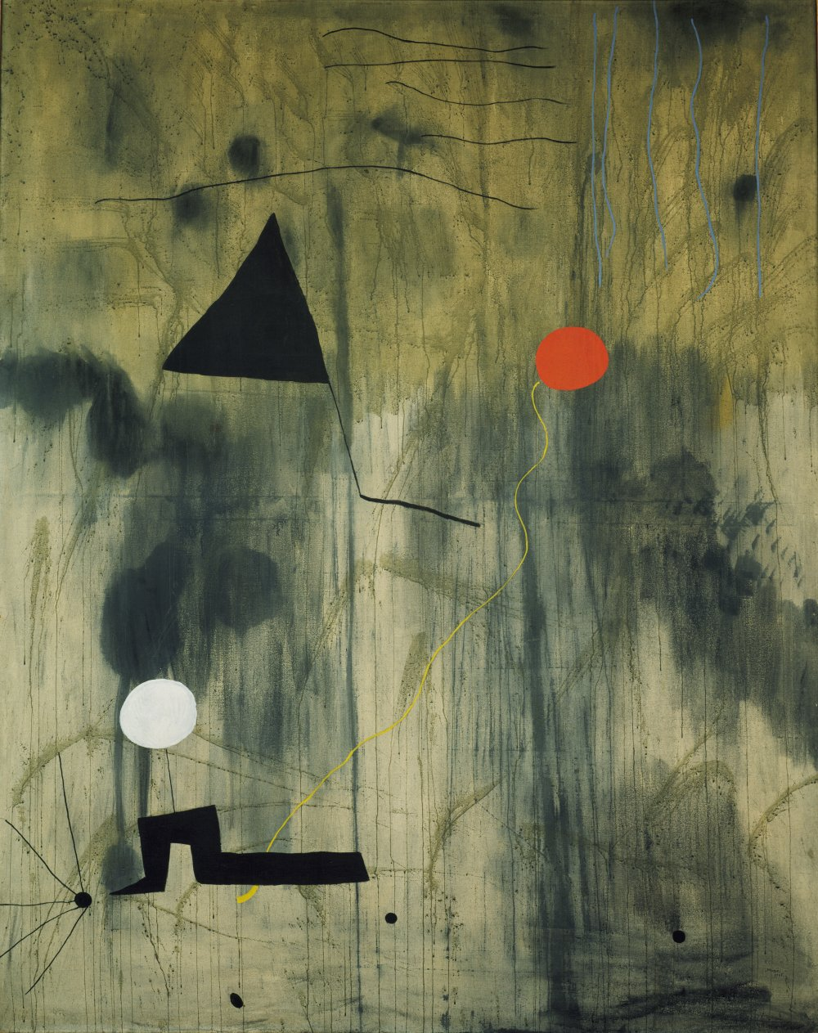
Miró. The Birth of the World. Montroig, late summer-fall 1925.
MoMA Surrealism Theme
Notes:
Share this information with your students:
Freud and other psychoanalysts used a variety of techniques to excavate the subconscious thoughts of their patients. The Surrealists borrowed many of the same techniques to stimulate their writing and art, with the belief that the creativity that came from deep within a person’s subconscious could be more powerful and authentic than any product of conscious thought.
In psychology, “automatism” refers to involuntary actions and processes not under the control of the conscious mind—for example, dreaming, breathing, or a nervous tic. Automatism plays a role in Surrealists techniques such as spontaneous or automatic writing, painting, drawing; free association of images to words and text, and collaborative creation though games like “Exquisite Corpse”.
To begin, Miró poured, brushed, and flung paint on an unevenly primed canvas so that the canvas was soaked in some places, while the paint rested on top in others. From this relatively uncontrolled process emerged patches, to which the artist added lines, amorphous shapes, and earth-toned colors. Miró once said that The Birth of the World depicts "a sort of genesis"-- the amorphous beginnings of life.
Joan Miró. The Birth of the World. Montroig, late summer-fall 1925.
Oil on canvas. 8' 2 3/4" x 6' 6 3/4" (250.8 x 200 cm)
Acquired through an anonymous fund, the Mr. and Mrs. Joseph Slifka and Armand G. Erpf Funds, and by gift of the artist.
© 2011 Successió Miró / Artists Rights Society (ARS), New York / ADAGP, Paris
262.1972

Slide 6
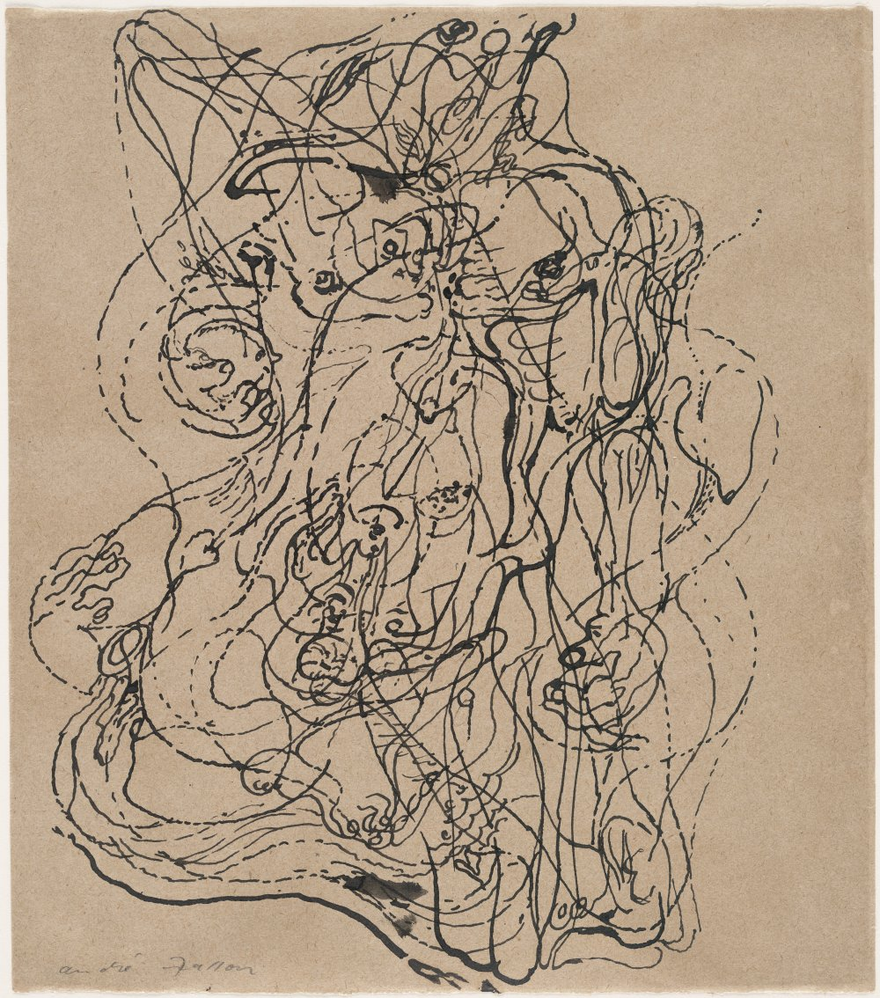
André Masson. Automatic Drawing. 1924.
MoMA Surrealism Theme
Notes:
Share this information with your students:
Masson began automatic drawings such as this with no preconceived subject or composition in mind. Like a medium channeling a spirit, he let his pen travel rapidly across the paper without conscious control. He soon found hints of images—anatomical fragments and objects—manifesting themselves within that abstract, lacelike web of pen marks. At times Masson elaborated on these clues with conscious changes or additions, but left the traces of the rapidly drawn ink mostly intact.
André Masson. Automatic Drawing. 1924.
Ink on paper
9 1/4 x 8 1/8" (23.5 x 20.6 cm). Given anonymously.
© 2011 Artists Rights Society (ARS), New York / ADAGP, Paris
873.1978

Slide 7
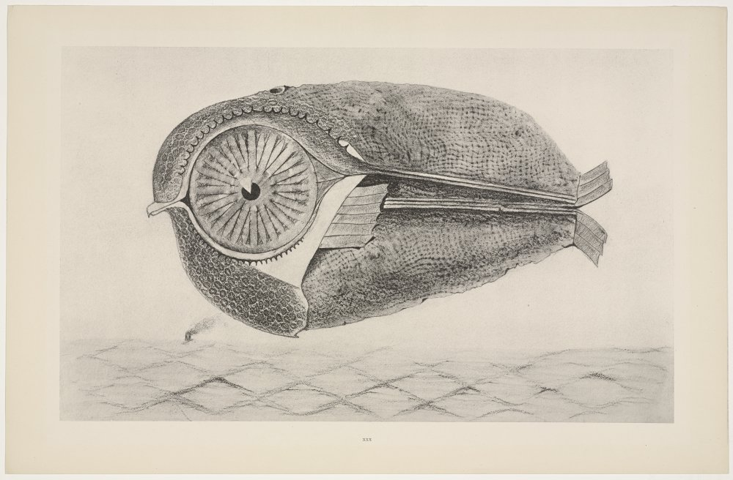
Max Ernst. L'évadé (The Fugitive) from Histoire Naturelle (Natural History). 1926 (Reproduced frottages executed c. 1925)
MoMA Surrealism Theme
Notes:
Share this information with your students:
Ernst experimented with the technique of frottage, or rubbing, as a way to probe the unconscious mind. He created these images by placing a sheet of paper on various materials—wood floorboards, lengths of twine, wire mesh, crumpled paper, crusts of bread—then rubbing the surface with a pencil or crayon. Ernst elaborated upon the resulting textures, often transforming them into strange and fantastic landscapes, objects, or in this case, life-like creatures.
Max Ernst. L'évadé (The Fugitive) from Histoire Naturelle (Natural History). 1926 (Reproduced frottages executed c. 1925)
One from a portfolio of thirty-four collotypes, after frottage, composition: 10 1/4 x 16 3/4" (26 x 42.5 cm); sheet: 12 13/16 x 19 11/16" (32.5 x 50 cm). Publisher: Galerie Jeanne Bucher, Paris. Printer: unknown. Edition: 300. Gift of James Thrall Soby.
© 2011 Artists Rights Society (ARS), New York / ADAGP, Paris
29.1958.30

Slide 8
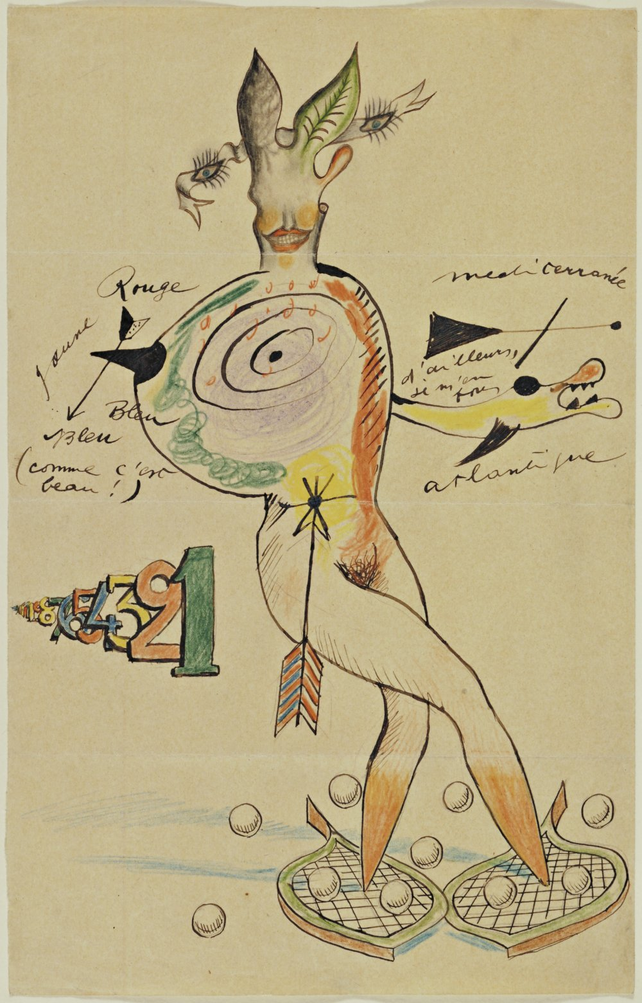
Cadavre Exquis (Exquisite Corpse) with Yves Tanguy, Joan Miro, Max Morise, and Man Ray. Nude. 1926-27.
MoMA Surrealism Theme
Notes:
Share this information with your students:
Among Surrealist techniques exploiting accident and subconscious associations was cadaver exquis (exquisite corpse), a game of collective creation typically involving four players. Each participant would write a phrase, draw an image (or on rarer occasions paste something down) on a sheet of paper, fold the paper to conceal part of it, and pass it on to the next player for his contribution. The Surrealists playing this round were Yves Tanguy, Joan Miró, Max Morise, and Man Ray.
Cadavre Exquis (Exquisite Corpse) with Yves Tanguy, Joan Miro, Max Morise, and Man Ray. Nude. 1926-27.
Composite drawing of ink, pencil, and colored pencil on paper.
14 1/8 x 9" (35.9 x 22.9 cm).
Purchase
260.1935

Slide 9
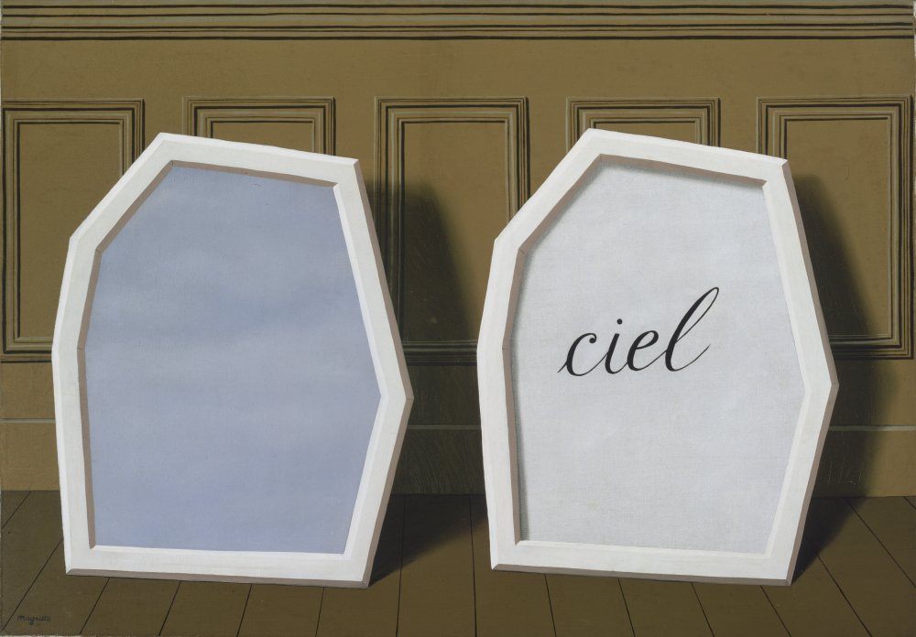
René Magritte. The Palace of Curtains, III. Le Perreux-sur-Marne, 1928-29.
MoMA Surrealism Theme
Notes:
Share this information with your students:
The Palace of Curtains, III is one in a series of paintings exploring the resonances between words and images. Leaning against a wood paneled wall are two enigmatic shapes with nearly identical profiles. Each of the twin shapes frame a bit of sky, the first by depicting a visual illusion of it, the other by designating it with words (the French word ciel, or sky). Adding to a sense of mystery is the presence of blue sky—that expansive symbol of the outdoors-- against the finite backdrop of a wall.
René Magritte. The Palace of Curtains, III. Le Perreux-sur-Marne, 1928-29.
Oil on canvas. 32 x 45 7/8" (81.2 x 116.4 cm).
The Sidney and Harriet Janis Collection.
© 2011 C. Herscovici, Brussels / Artists Rights Society (ARS), New York
631.1967

Slide 10
Surrealist Object and Assemblages
MoMA Surrealism Theme

Slide 11
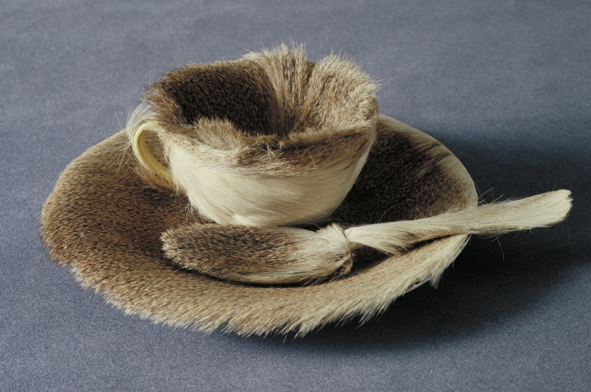
Meret Oppenheim. Object. Paris, 1936.
MoMA Surrealism Theme
Notes:
Share this information with your students:
Many Surrealist artists, especially in the 1930s, began arranging everyday objects in bizarre combinations that challenged reason and summoned unconscious and poetic associations. Surrealist leader André Breton believed that this new form of sculpture, called assemblage, had the power to puncture the thin veneer of reality, allowing the unconscious mind to break through.
Name some traditional uses for the individual materials (cup, spoon, saucer, fur) used to make Object. What choices do you think Oppenheim made to transform these materials and objects?
In 1936, the Swiss artist Oppenheim was at a café in Paris with her friends Pablo Picasso and Dora Maar.Oppenheim was wearing a bracelet she had made from fur-lined, polished metal tubing. Picasso joked that one could cover anything with fur, to which Oppenheim replied, “Even this cup and saucer.” Her tea was getting cold, and she reportedly called out,“Waiter, a little more fur!” Soon after, when asked to participate in a Surrealist exhibition, she bought a cup, saucer, and spoon at a department store and lined them with the fur of a Chinese gazelle.
FUN FACT: This was the first work by a female artist acquired by The Museum of Modern Art.
Meret Oppenheim. Object. Paris, 1936.
Fur-covered cup, saucer, and spoon, cup. 4 3/8" (10.9 cm) in diameter; saucer 9 3/8" (23.7 cm) in diameter; spoon 8" (20.2 cm) long, overall height 2 7/8" (7.3 cm).
Purchase
© 2011 Artists Rights Society (ARS), New York / Pro Litteris, Zurich
130.1946.a-c

Slide 12
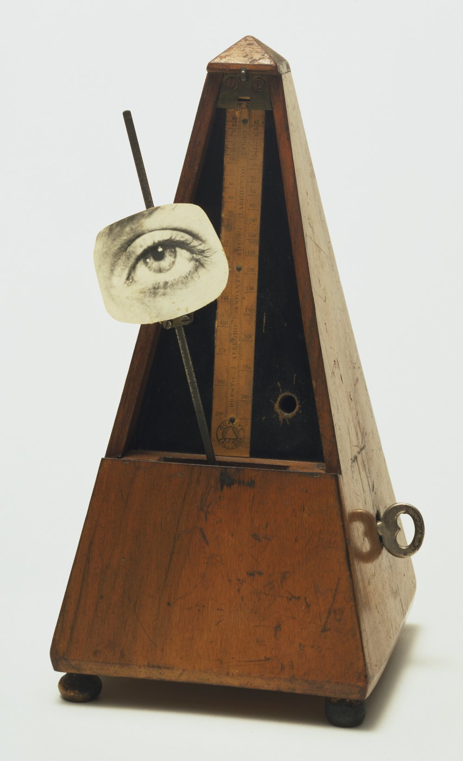
Man Ray. Indestructible Object. 1964 (replica of 1923 original).
MoMA Surrealism Theme
Notes:
Share this information with your students:
Devastated after his girlfriend and fellow photographer Lee Miller broke up with him in 1933, Man Ray cut out and attached a photograph of her eye to the pendulum of a metronome. In instructions accompanying the work, he invites us to create our own “Indestructible Object” :
Cut out the eye from the photograph of one who has been loved but is seen no more. Attach the eye to the pendulum of a metronome and regulate the weight to suit the tempo desired. Keep going to the limit of endurance. With a hammer well-aimed, try to destroy the whole at a single blow.
Quite radically, Man Ray’s instructions encourage us to destroy the very work of art he instructs us to create. Have your students consider what it means to destroy art.
Ask your students how they would perceive this work differently if the image attached to the metronome were a nose, an ear, or the eye of a person whom they know.
Man Ray. Indestructible Object. 1964 (replica of 1923 original).
Metronome with cutout photograph of eye on pendulum. 8 7/8 x 4 3/8 x 4 5/8" (22.5 x 11 x 11.6 cm).
James Thrall Soby Fund
© 2011 Man Ray Trust / Artists Rights Society (ARS), New York / ADAGP, Paris
248.1966.a-e

Slide 13
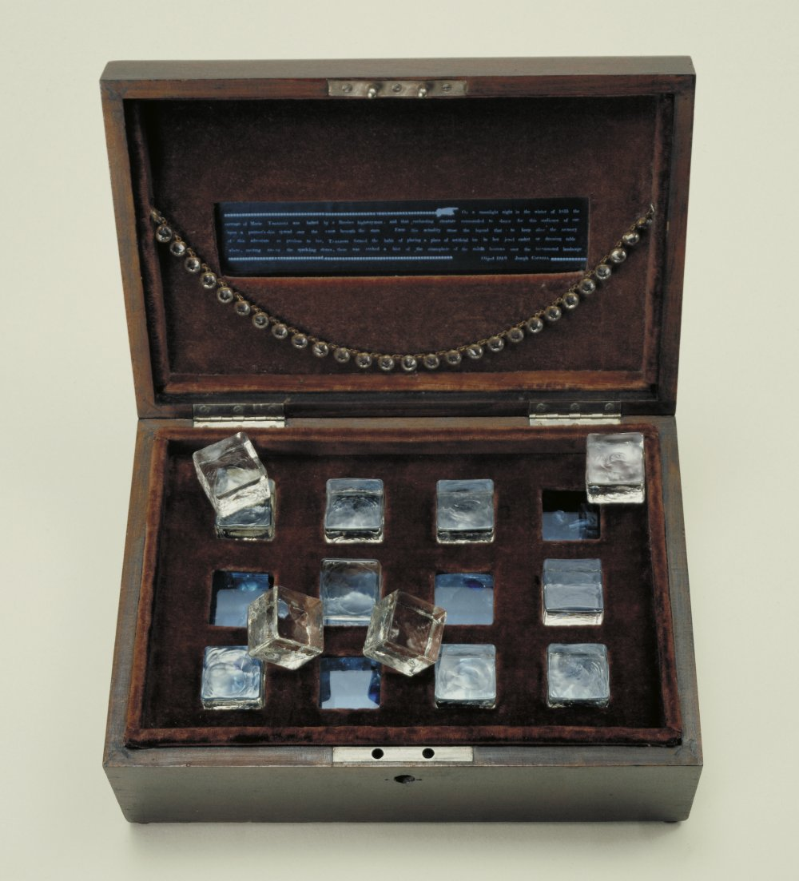
Joseph Cornell. Taglioni's Jewel Casket. 1940.
MoMA Surrealism Theme
Notes:
Share this information with your students:
Oppenheim, Man Ray, and Cornell transformed everyday objects into Surrealist assemblages. Ask your students to think about the three artworks they’ve seen thus far and discuss the similarities and differences between these artists’ transformation of everyday objects.
Joseph Cornell. Taglioni's Jewel Casket. 1940.
Wood box covered with velvet containing three rows of four glass cubes resting in slots on blue glass, glass necklace, jewelry fragments, and red, blue, and clear glass chips
4 3/4 x 11 7/8 x 8 1/4" (12 x 30.2 x 21 cm)
Gift of James Thrall Soby
474.1953

Slide 14
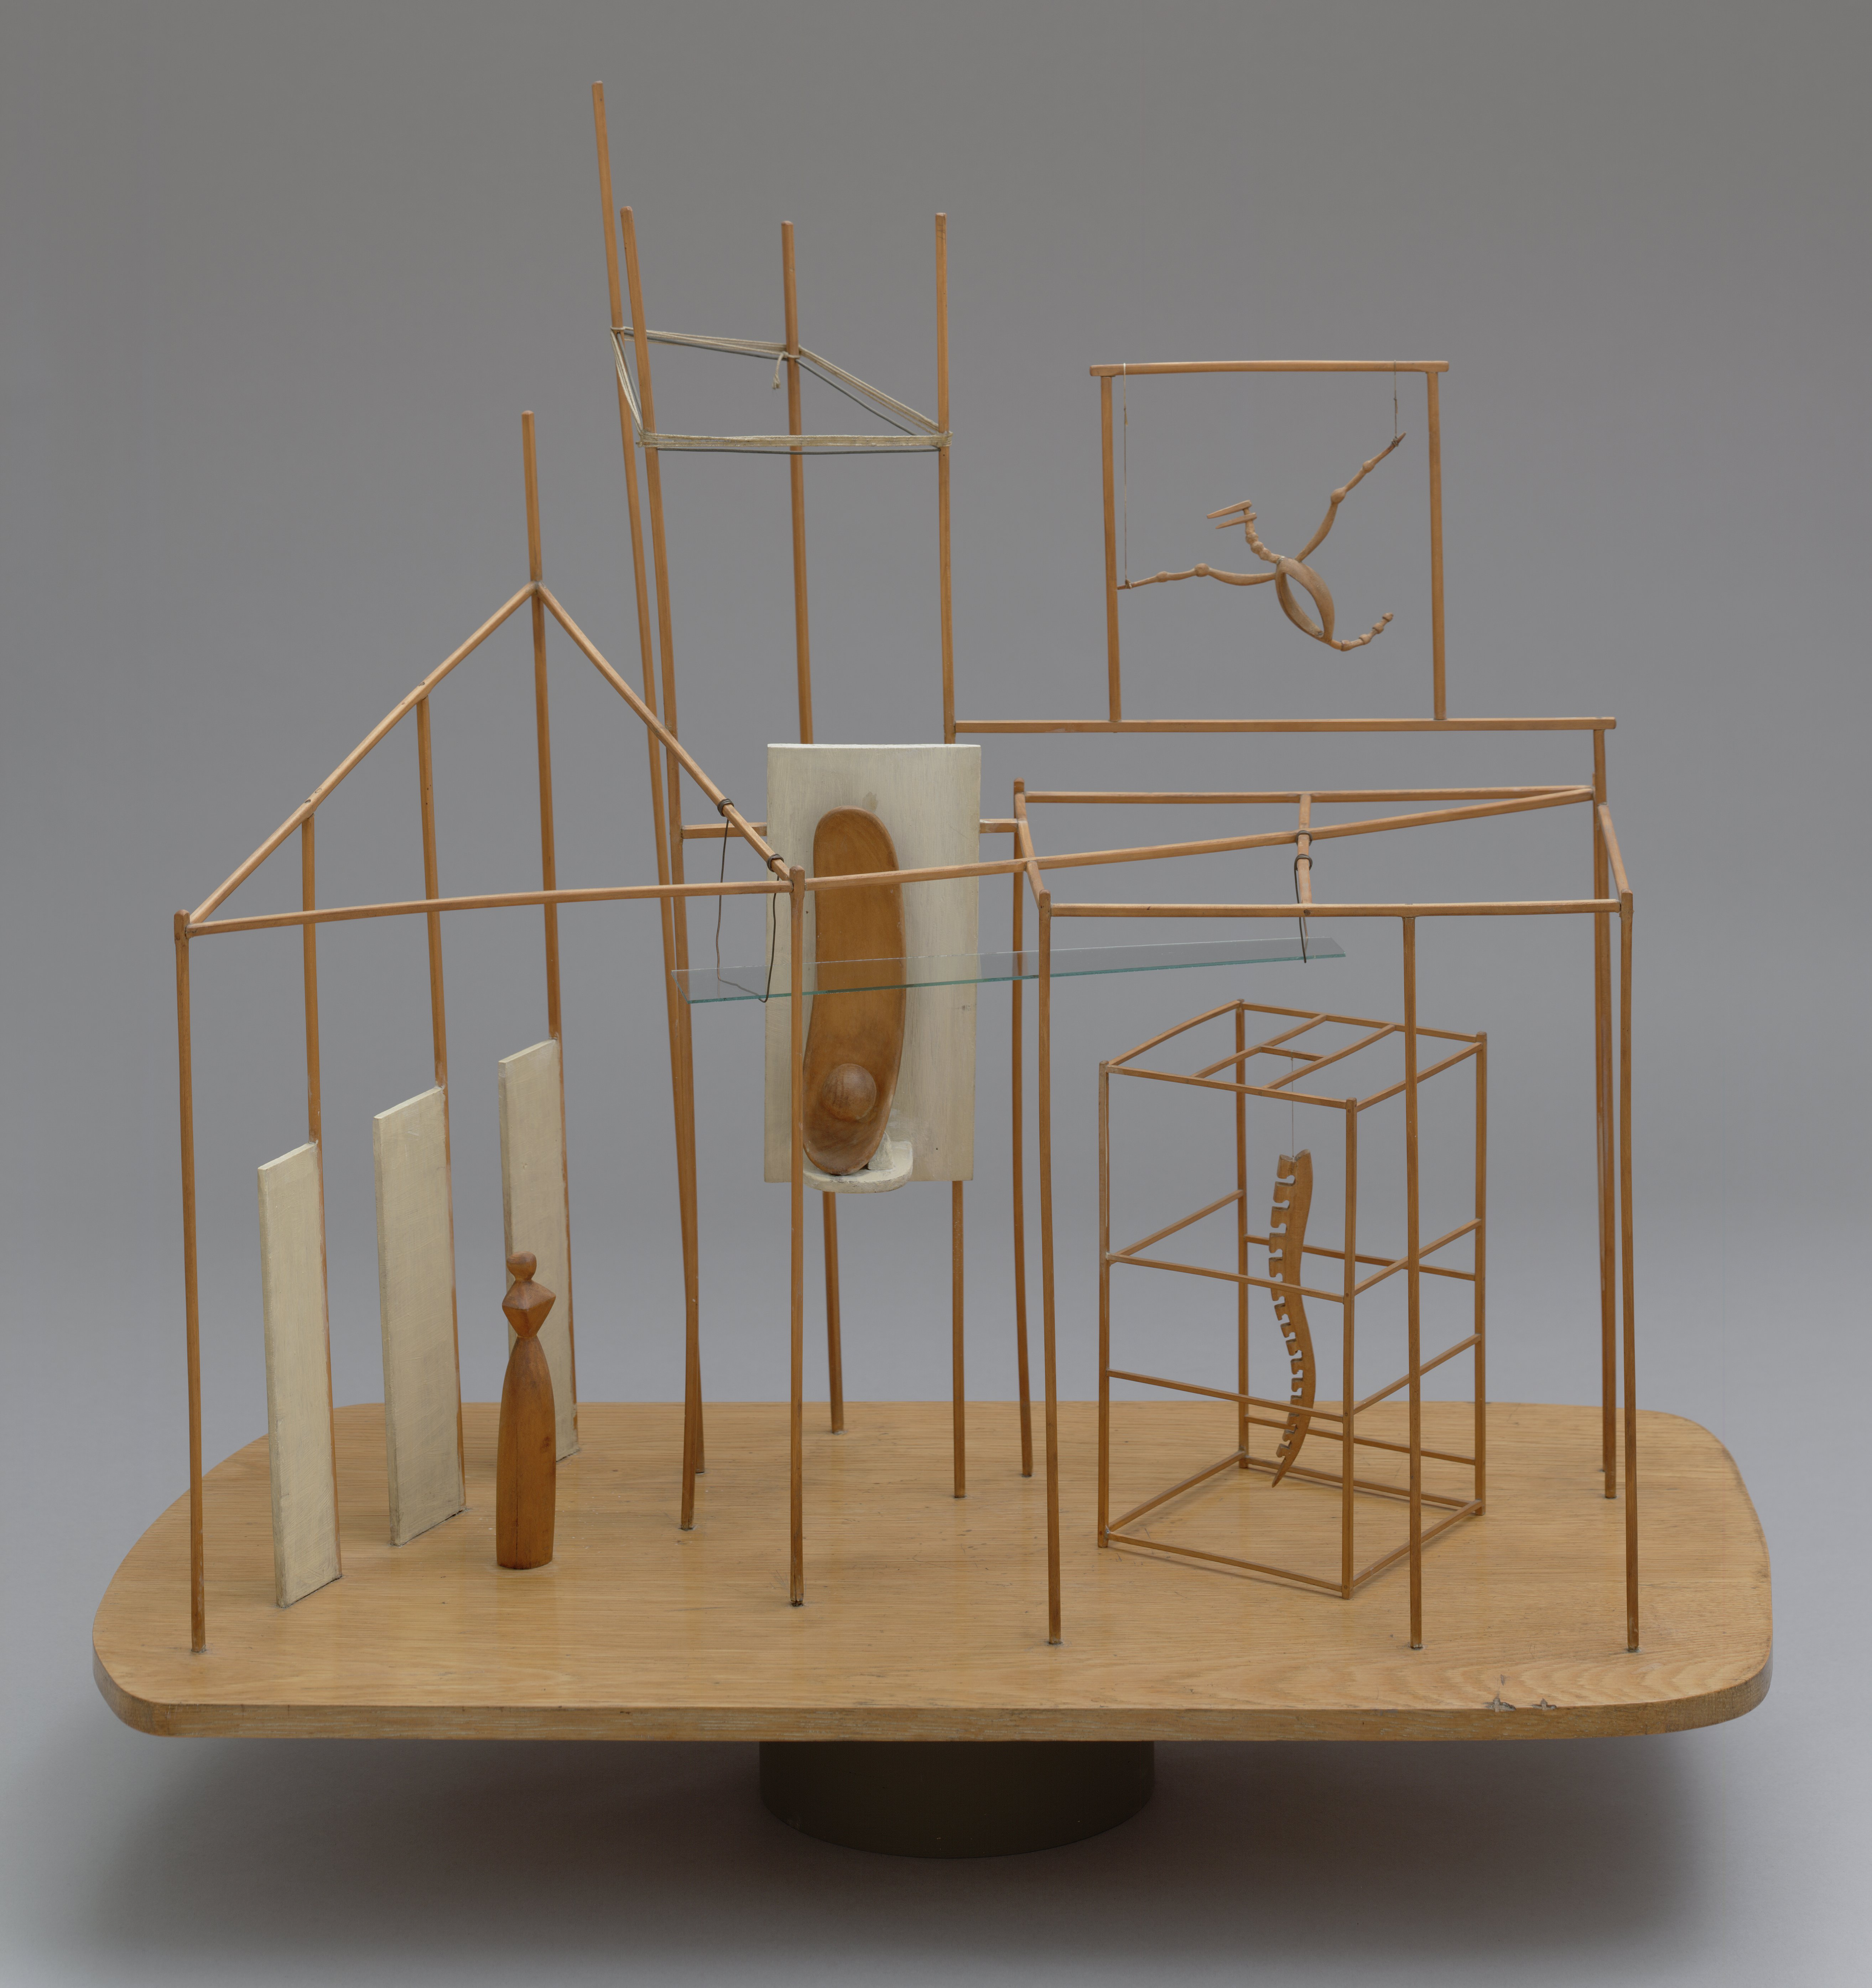
Alberto Giacometti. The Palace at 4 a.m. 1932.
MoMA Surrealism Theme
Notes:
Share this information with your students:
The Palace at 4 A.M., with its spindly wood scaffolding, sheet of glass, and delicate skeletal structure is a vertical, immaterial drawing in space. In 1933, Giacometti wrote that the scenes in this and other sculptures came to him “entirely completed,” and that he tried to reproduce these visions “in space without changing anything”.
Alberto Giacometti. The Palace at 4 a.m. 1932.
Wood, glass, wire, and string, 25 x 28 1/4 x 15 3/4" (63.5 x 71.8 x 40 cm). Purchase
© 2011 Artists Rights Society (ARS), New York / ADAGP, Paris
90.1936

Slide 15
Surrealism and the Body
MoMA Surrealism Theme

Slide 16
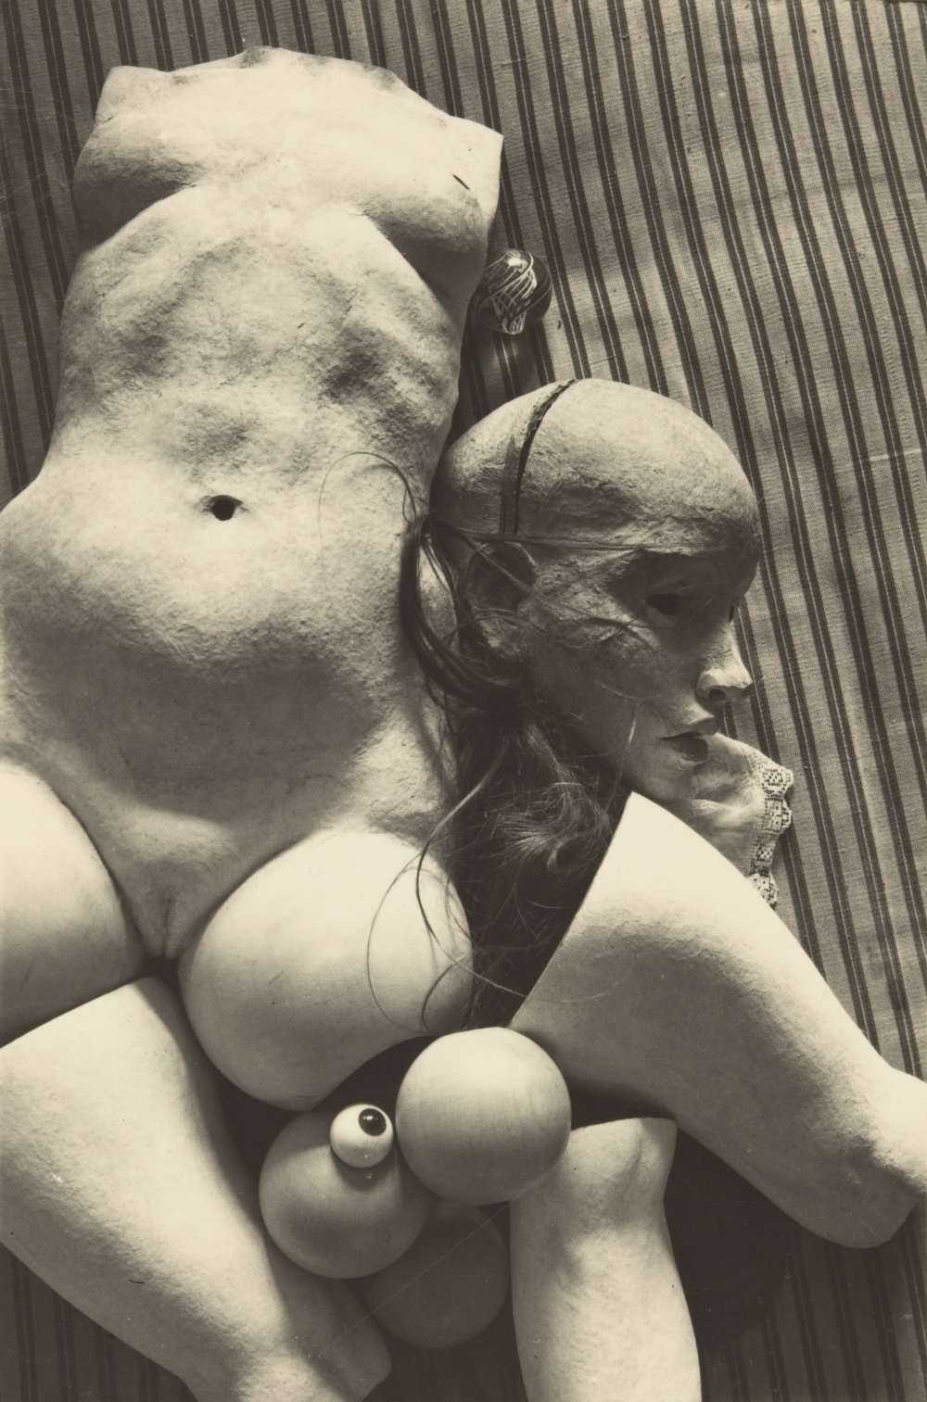
Hans Bellmer. Plate from La Poupée. 1936.
MoMA Surrealism Theme
Notes:
Share this information with your students:
Beginning in the early 1930s, many Surrealists turned to object-making with particular vigor. Many of these photographs, objects, and sculptures had an insistently erotic dimension, and featured vaguely life-like biomorphic forms, and isolated body parts.
Surrealists shocked viewers by breaking taboos long established in polite society. Surrealist bodies are often mutilated, dismembered, disturbingly positioned or distorted.
This plate is one in a series of photographs published in the Surrealist publication Minotaure in 1934. The series depicts a female mannequin, La Poupée in various stages of construction, from wood and metal skeleton to the fleshy plaster and papier-mâché shell. A system of ball joints allowed Bellmer to dismantle and reassemble the doll in many combinations. The erotic theme of the doll was a lifetime obsession for Bellmer.
Bellmer began creating and photographing these disturbing dolls in 1933, the year Adolf Hitler assumed power in Germany. Many have interpreted them as acts of political defiance against the Aryan ideals and social norms promoted by the Nazis, whom he openly opposed, and expressions of the personal outrage he felt towards his father, who had joined the Nazi party.
Hans Bellmer. Plate from La Poupée. 1936.
Gelatin silver print. 4 5/8 x 3" (11.7 x 7.6 cm)
Purchase
© 2011 Artists Rights Society (ARS), New York / ADAGP, Paris
9.1994.8

Slide 17
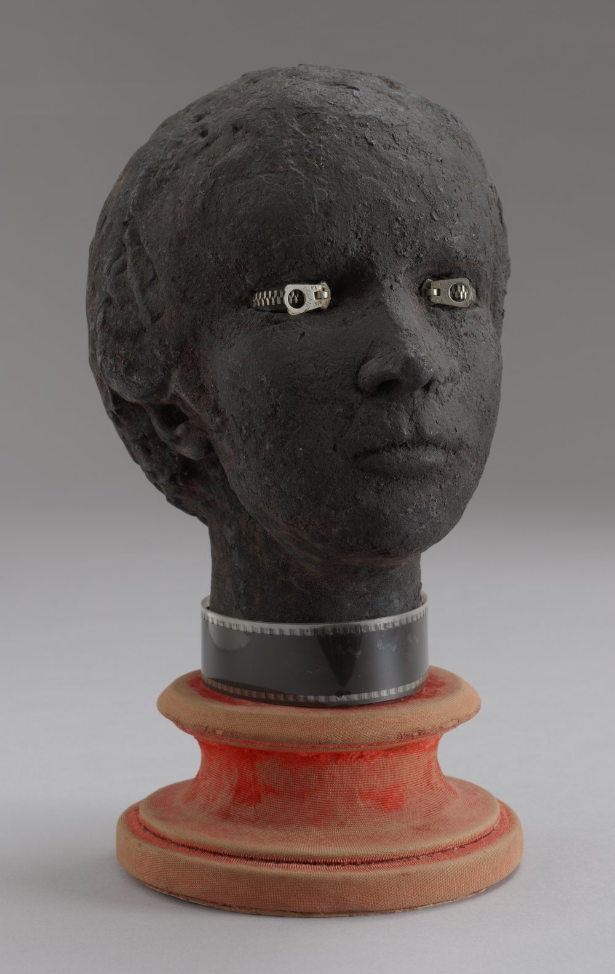
Marcel Jean. Specter of the Gardenia. 1936.
MoMA Surrealism Theme
Notes:
Share this information with your students:
With zippers for eyes and a filmstrip collar around its neck, this figure composes an anxious portrait, but its tactile surface of black cloth, red velvet, and zippers for eyes is charged with the eroticism of imagined touch.
Marcel Jean. Specter of the Gardenia. 1936.
Plaster head with painted black cloth, zippers, and strip of film on velvet-covered wood base.
13 7/8 x 7 x 9 7/8" (35 x 17.6 x 25 cm) including base 3" high x 7" diameter (7.5 x 17.6 cm)
D. and J. de Menil Fund
229.1968

Slide 18
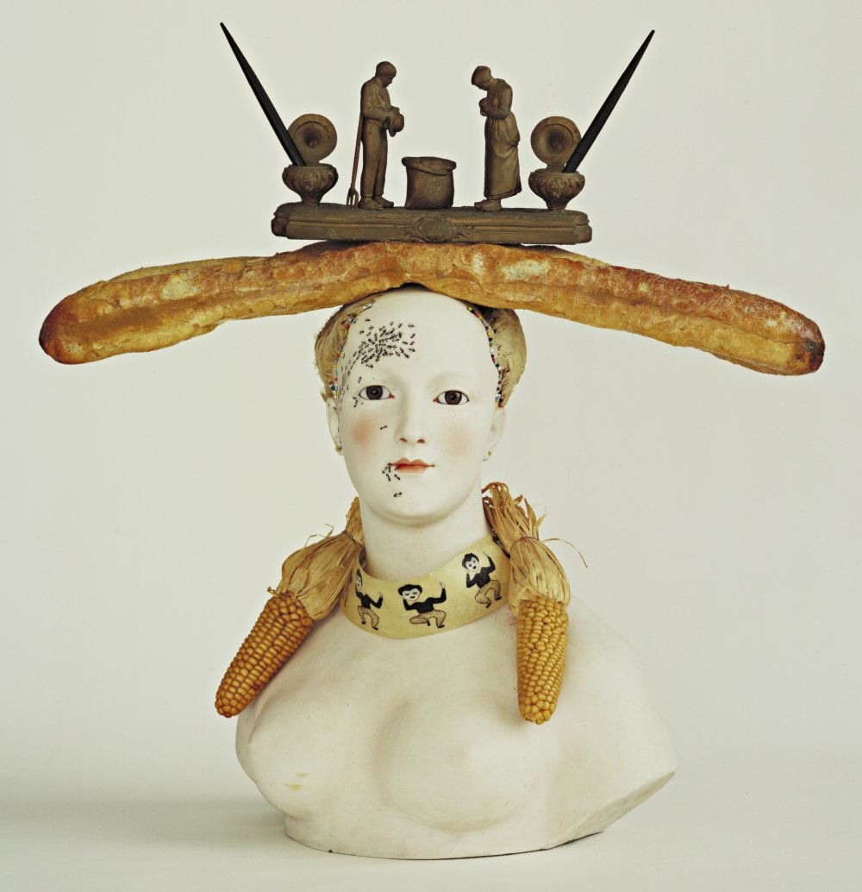
Salvador Dalí. Retrospective Bust of a Woman. 1933 (some elements reconstructed 1970)
MoMA Surrealism Theme
Notes:
Share this information with your students:
Retrospective Bust of a Woman not only presents a woman as an object, but explicitly as one to be consumed. A baguette crowns her head, cobs of corn dangle around her neck, and ants swarm along her forehead as if gathering crumbs.
The genesis of this work was his discovery of an inkwell featuring the praying couple from Jean-Francois Millet's painting The Angelus (1857–59) . He embedded the inkwell in a loaf of bread and placed them both on the bust of a woman. The necklace is a strip of repeating images from a zoetrope, a pre-cinematic toy that provides the illusion of movement as it rotates.
Salvador Dalí. Retrospective Bust of a Woman. 1933 (some elements reconstructed 1970)
Painted porcelain, bread, corn, feathers, paint on paper, beads, ink stand, sand, and two pens
29 x 27 1/4 x 12 5/8" (73.9 x 69.2 x 32 cm)
Acquired through the Lillie P. Bliss Bequest and gift of Philip Johnson (both by exchange)
© 2011 Salvador Dalí, Gala-Salvador Dalí Foundation / Artists Rights Society (ARS), New York
301.1992

Slide 19
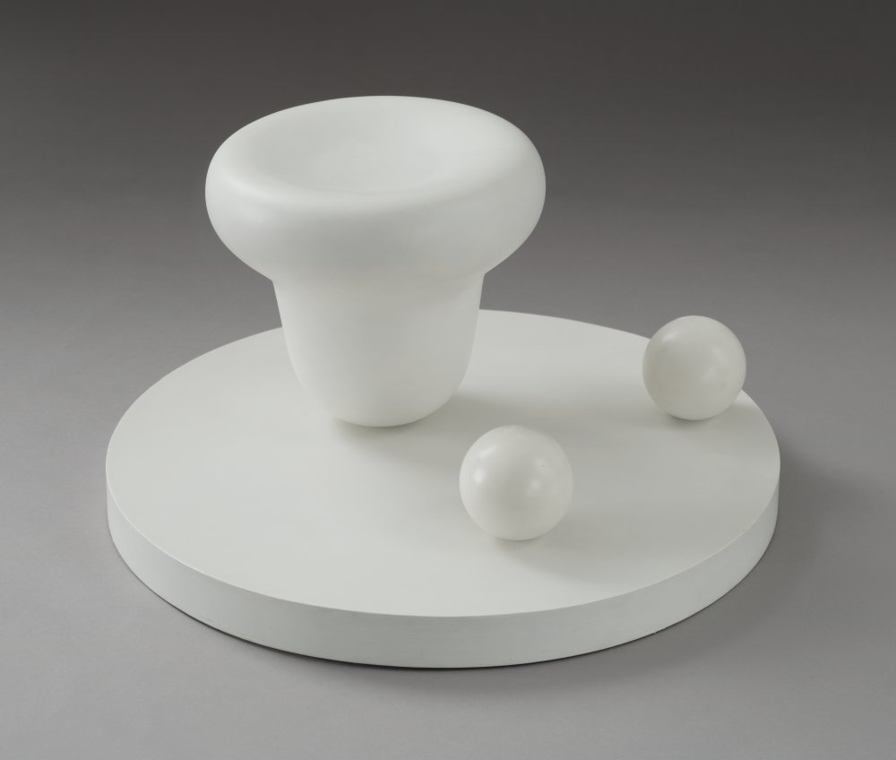
Jean (Hans) Arp. Bell and Navels. 1931.
MoMA Surrealism Theme
Notes:
Share this information with your students:
The title of this sculpture identifies its two spherical shapes as navels and the larger, upturned form as a bell. The navel was one of Arp's signature motifs—it resonated with him as a symbol of birth, growth, and fertility. In his work it can resemble an egg, a seed, a womb, and as paired here, breasts. As Arp explained, "It's the first thing that exists, the beginning." He connected human life not only with the cycles of nature, but also with the act of artistic creation. The year he made this work Arp declared, "Art is a fruit that grows in man like a fruit on a plant or a child in its mother's womb."
Jean (Hans) Arp. Bell and Navels. 1931.
Painted wood. 10" (25.4 cm) high; 1 5/8" (4.2 cm) high x 19 3/8" (49.3 cm) diameter, including wood base.
Kay Sage Tanguy Fund
© 2011 Artists Rights Society (ARS), New York / VG Bild-Kunst, Bonn
219.1968

Slide 20
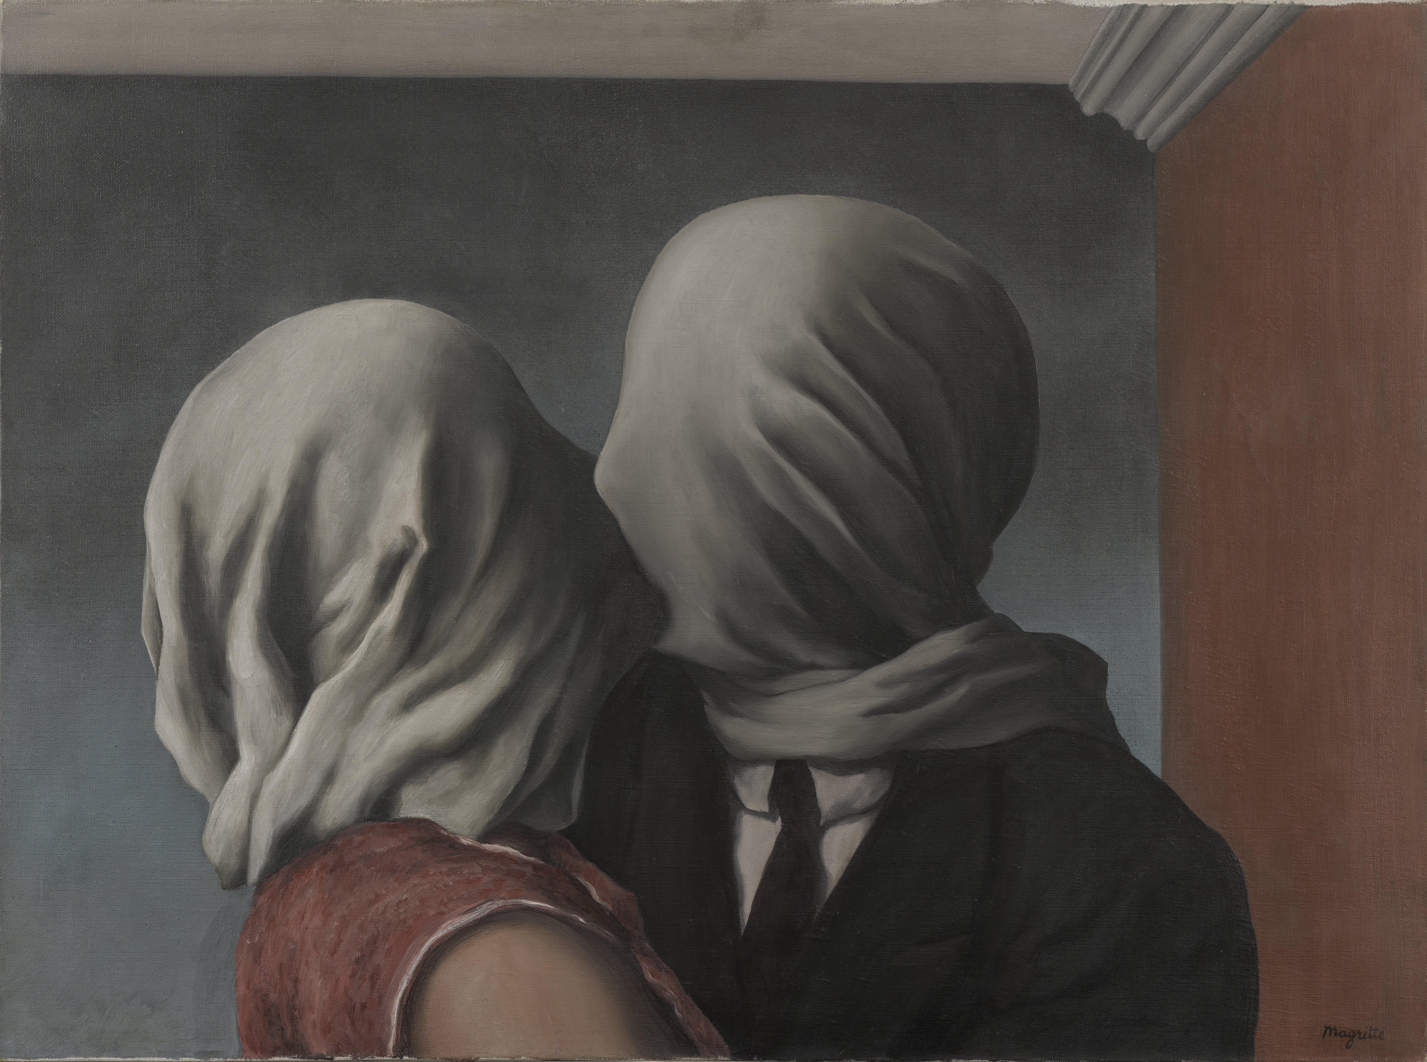
René Magritte. The Lovers. Le Perreux-sur-Marne, 1928.
MoMA Surrealism Theme
Notes:
Share this information with your students:
Frustrated desires are a common theme in Magritte’s work. Here, a barrier of fabric prevents the intimate embrace of two lovers, transforming an act of passion into isolation and frustration. Some have interpreted this work as a metaphor for the saying “love is blind”—the inability to fully perceive, acknowledge, or entirely unveil the true natures of even our most intimate companions.
Magritte was fourteen when his mother committed suicide by drowning. He witnessed her body being pulled from the water, her nightgown wrapped around her face. Most of the faces in Magritte’s paintings are blank and expressionless and many of the figures’ heads, like those in The Lovers, are covered in cloth.
René Magritte. The Lovers. Le Perreux-sur-Marne, 1928.
Oil on canvas. 21 3/8 x 28 7/8" (54 x 73.4 cm)
Gift of Richard S. Zeisler.
© 2011 C. Herscovici, Brussels / Artists Rights Society (ARS), New York
530.1998

Slide 21
SURREALIST LANDSCAPES
MoMA Surrealism Theme

Slide 22
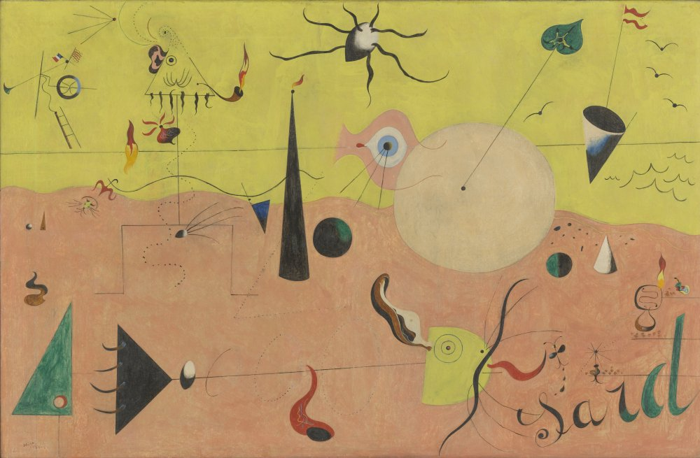
Joan Miró. The Hunter (Catalan Landscape). Montroig, July 1923-winter 1924.
MoMA Surrealism Theme
Notes:
Share this information with your students:
Ask your students to define “landscape” (a work of art whose primary focus is natural scenery). Ask your students why the painting might be considered a landscape. Ask them if they can identify natural or organic imagery in this, and in all other works in this section.
Call out five words that describe the place depicted in this painting. Explain your word choices using visual evidence from the work.
Locate the title figure, the hunter, in this painting (it’s the stick figure, with the mustachioed, triangle head, smoking a pipe). Find other parts of his body, like his heart (which shoots flame), his eye, his ear. This figure, also found in other paintings by Miró, is considered a self-portrait.
Pick out other iconography in this painting. For example, there’s a large beige circle, a cross section of a trunk of a carob tree that sprouts a leaf, and a giant eye bisected by the horizon line. Miró placed the word “Sard” (short for Sardana, the national dance of Catalonia) in the bottom right corner of the painting.
Joan Miró. The Hunter (Catalan Landscape). Montroig, July 1923-winter 1924.
Oil on canvas. 25 1/2 x 39 1/2" (64.8 x 100.3 cm).
Purchase
© 2011 Successió Miró / Artists Rights Society (ARS), New York / ADAGP, Paris
95.1936

Slide 23
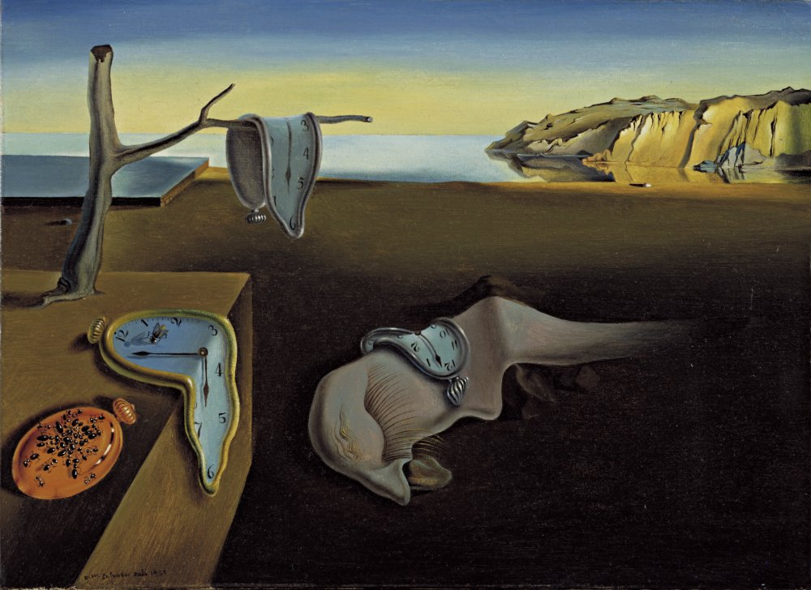
Let’s look at The Persistence of Memory by Salvador Dalí.
What is your definition of a landscape? Does this painting qualify under that definition?
Think of five words that describe the place in this painting.
Which elements are natural, and which from the artist’s imagination? Are there some that straddle the line between natural and imaginary?
Salvador Dalí. The Persistence of Memory. 1931.
MoMA Surrealism Theme
Notes:
Share this information with your students:
What is your definition of a landscape? Do you think this painting qualifies as a landscape? Why or why not? Can you identify natural or organic imagery in this painting? Write down five words that describe the place depicted in this painting.
Which elements in this painting come strictly from nature? Which elements might come from Dali’s imagination? Are there elements that straddle the line between natural and imaginary?
Dalí was very interested in Sigmund Freud’s writings on psychology. An Austrian psychologist writing in the late-nineteenth and early-twentieth century, Freud revolutionized the way people think about the mind with his theory of the unconscious. The unconscious is the part of the psyche that thinks and feels without the person being aware of those thoughts and
feelings. According to Freud, dreams are coded messages from the unconscious, and Surrealist artists were interested in what could be revealed by their dreams.
Influenced by Freud’s writings on dreams and the unconscious, Dalí self induced hallucinations in order to access his unconscious while creating works of art.He called this the “paranoiac-critical method.” On the results of this process, he wrote,“I am the first to be surprised and often terrified by the images I see appear upon my canvas. I register without choice and with all possible exactitude the dictates of my subconscious, my dreams. . . .”
Although he claimed to be surprised by the images, Dalí rendered them with meticulous precision, creating
the illusion that these places could exist in the real world. Dalí, in his typically ironic way, once said of himself,“The only difference between a madman and me is that I am not mad.”
Salvador Dalí. The Persistence of Memory. 1931.
Oil on canvas. 9 1/2 x 13" (24.1 x 33 cm)
Given anonymously
© 2011 Salvador Dalí, Gala-Salvador Dalí Foundation / Artists Rights Society (ARS), New York.
162.1934

Slide 24
Salvador Dalí. The Persistence of Memory. 1931.
MoMA Surrealism Theme
Notes:
Share this information with your students:
Salvador Dalí. The Persistence of Memory. 1931.
Oil on canvas. 9 1/2 x 13" (24.1 x 33 cm)
Given anonymously
© 2011 Salvador Dalí, Gala-Salvador Dalí Foundation / Artists Rights Society (ARS), New York.
162.1934

Slide 25
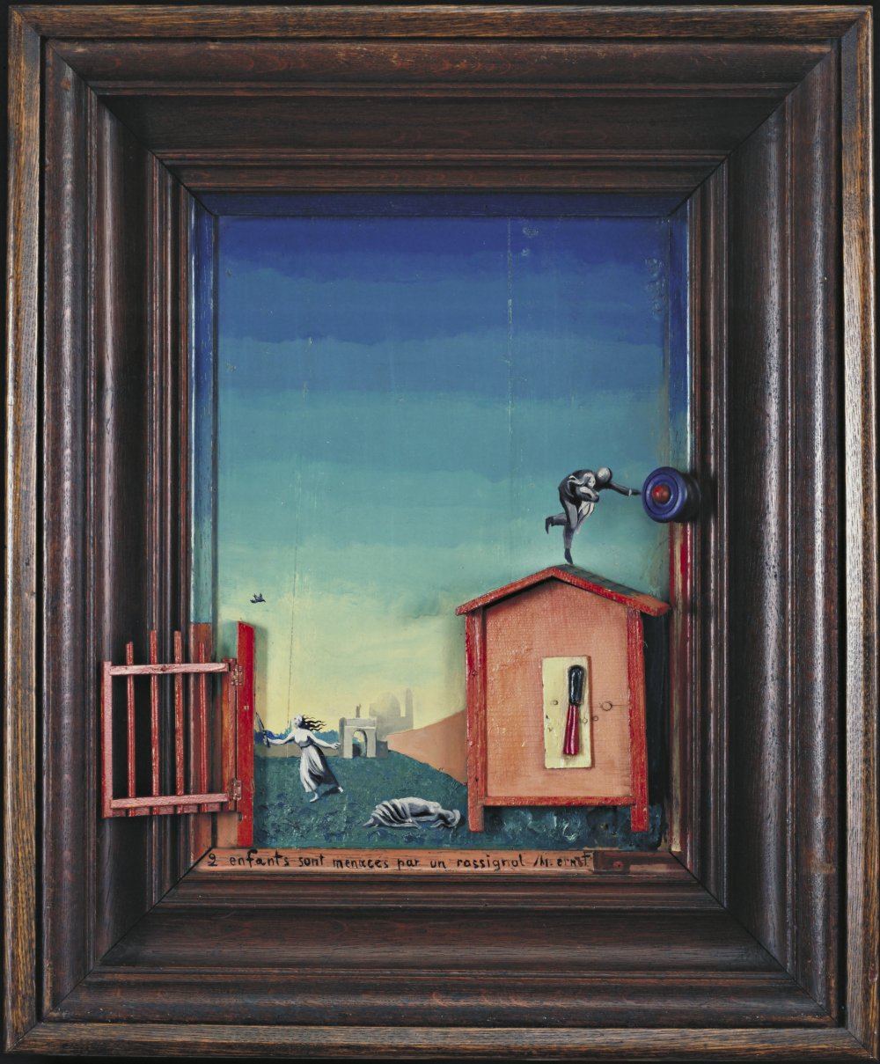
Let’s look at Two Children Are Threatened by a Nightingale by Max Ernst.
Does knowing the title of this work change what your think of this painting?
Which figures are the two children? Who might the other figures be?
How might this relate to the artist’s interest in dreams?
Max Ernst. Two Children Are Threatened by a Nightingale. 1924.
MoMA Surrealism Theme
Notes:
Share this information with your students:
Does knowing the title of this work, Two Children Are Threatened by a Nightingale, change what you think of this painting? There are more than two figures in this work, can you tell which figures are the two children? Who might the other figures be?
Why do you think Ernst combined three-dimensional objects with his painting? Why do you think Ernst extended the painting to the inner edge of the frame? Might this relate to the artist’s interest in dreams?
Max Ernst. Two Children Are Threatened by a Nightingale. 1924.
Oil on wood with painted wood elements and frame. 27 1/2 x 22 1/2 x 4 1/2" (69.8 x 57.1 x 11.4 cm)
Purchase
© 2011 Artists Rights Society (ARS), New York / ADAGP, Paris
256.1937

Slide 26
Max Ernst. Two Children Are Threatened by a Nightingale. 1924.
MoMA Surrealism Theme
Notes:
Share this information with your students:
Max Ernst. Two Children Are Threatened by a Nightingale. 1924.
Oil on wood with painted wood elements and frame. 27 1/2 x 22 1/2 x 4 1/2" (69.8 x 57.1 x 11.4 cm)
Purchase
© 2011 Artists Rights Society (ARS), New York / ADAGP, Paris
256.1937

