Slide 1
Abstract Expressionism

Slide 2
Processes and Materials of Abstract Expressionist Painting
MoMA Abstract Expressionism

Slide 3
Questions
Why might an artist choose to paint abstractly instead of representationally—depicting figures, shapes, objects, or scenes?
What kinds of choices do artists make when painting?
What kinds of materials and techniques does a painter use?
MoMA Abstract Expressionism
Notes:
Share this information with your students:
Why might an artist choose to paint abstractly instead of representationally—depicting figures, shapes, objects, or scenes?
What kinds of choices do artists make when painting?
What kinds of materials and techniques does a painter use?
Abstract Expressionist painters explored new ways of creating art, reinvigorating and reinventing the medium. They changed the nature of painting with their large, abstract canvases, energetic and gestural lines, and new artistic processes.

Slide 4
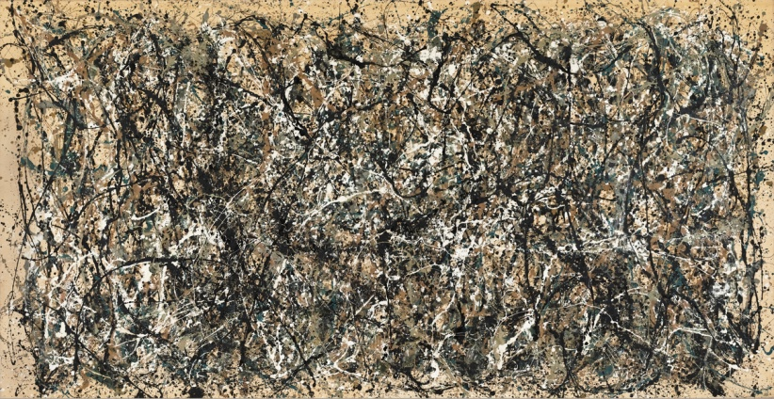
Take a close look at One: Number 31, by Jackson Pollock
What words would you use to describe this painting?
How would you describe the lines in the painting?
What kind of gestures or movements do you think Pollock made to make this painting? What do you see that makes you think that?
Jackson Pollock. One: Number 31. 1950
MoMA Abstract Expressionism
Notes:
Share this information with your students:
What words would you describe this painting?
How would you describe the lines in the painting?
What kind of gestures or movements do you think Pollock made to make this painting? What do you see that makes you think that?
Pollock experimented with nontraditional materials, using commercial paints and housepainter’s brushes. He also moved the canvas from the easel to the floor and worked on unstretched and unprimed canvas. To do this, Pollock poured, dribbled, and flicked enamel paint onto the surface, sometimes straight from the can, or using sticks and stiffened brushes. He put holes in the bottom of paint cans, squeezed paint from a tube, and even used a turkey baster or stiff brush.
Pollock once described his process: "My painting does not come from the easel…I prefer to tack the unstretched canvas to the hard wall or floor...On the floor, I am more at ease. I feel nearer, more a part of the painting, since this way I can walk around it, work from the four sides and literally be in the painting. I prefer sticks, trowels, knives and dripping fluid paint…When I am in my painting, I'm not aware of what I'm doing. It is only when I lose contact with the painting that the result is a mess. Otherwise there is pure harmony, an easy give and take, and the painting comes out well.“ (Jackson Pollock, “My Painting,” Possibilities I (Winter 1947–48), 78–83.)

Slide 5
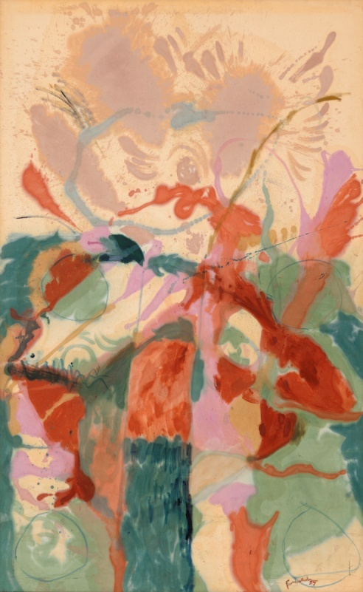
Let’s look at Jacob’s Ladder, by Helen Frankenthaler
What kinds of shapes do you see in her work?
Based on what you see, what gestures or movements do you think Frankenthaler made?
Helen Frankenthaler. Jacob’s Ladder. 1928
MoMA Abstract Expressionism
Notes:
Share this information with your students:
What kinds of shapes do you see in her work?
Based on what you see, what gestures or movements do you think Frankenthaler made when making this painting?
Frankenthaler developed a painting technique in which she thinned pigments with turpentine so that they soaked through and stained the unprimed canvas rather than resting on the surface.

Slide 6
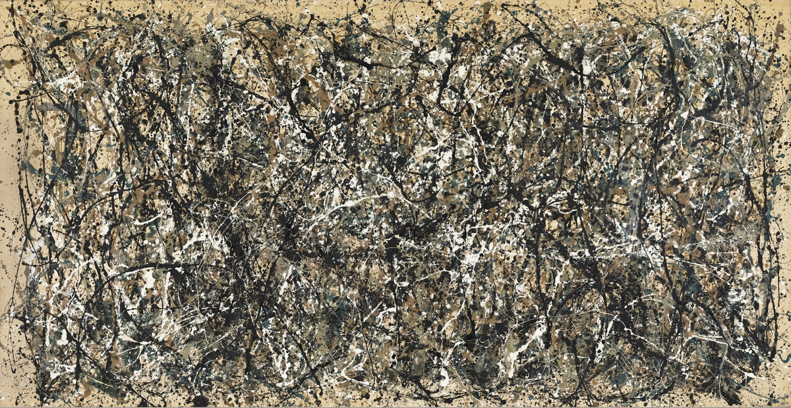
Let’s compare works by Pollock and Frankenthaler
Jackson Pollock. One: Number 31. 1950
Helen Frankenthaler. Jacob’s Ladder. 1928
How are these paintings similar? How are they different?
MoMA Abstract Expressionism

Slide 7
Frankenthaler has spoken about opposites in her work—about a combination of freedom and restraint; accident and control.
Do you think Frankenthaler’s and Pollock’s paintings are governed by chaos or control?
Helen Frankenthaler. Jacob’s Ladder. 1928
MoMA Abstract Expressionism
Notes:
Share this information with your students:
Frankenthaler has spoken about opposites in her work—about a combination of freedom and restraint; accident and control.
Do you think Frankenthaler and Pollock’s paintings are governed by chaos or control?
Despite the seemingly spontaneous appearance of his paintings, Pollock rejected the interpretation that his paintings were chaotic. A critic once wrote of Pollock’s work, “It is easy to detect the following things in all of his paintings: Chaos. Absolute lack of harmony. Complete lack of structural organization. Total absence of technique, however rudimentary. Once again, chaos,” to which the artist replied, “No chaos, damn it.” (Jackson Pollock, quoted in Kirk Varnedoe, Jackson Pollock (New York: The Museum of Modern Art, 1998), 70.)

Slide 8
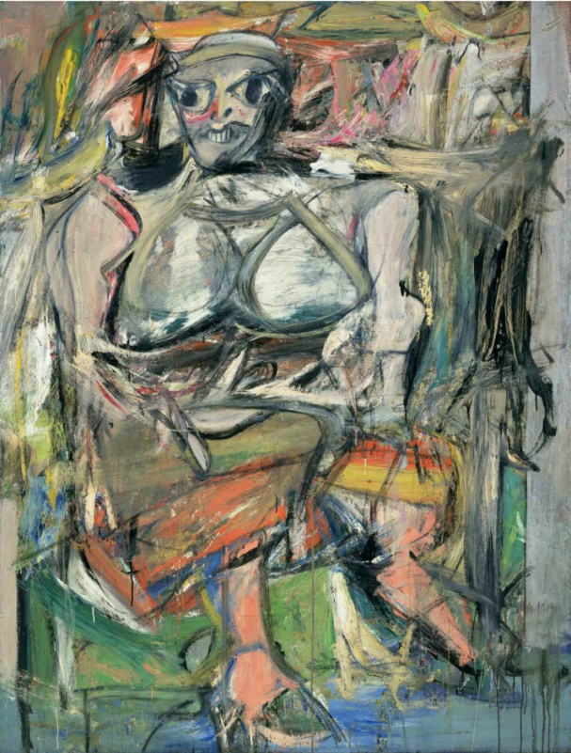
Take a close look at Woman, I, by Willem de Kooning…
What words would you use to describe this painting?
How has de Kooning chosen to represent this woman?
Willem De Kooning. Woman, I. 1950 – 52
MoMA Abstract Expressionism
Notes:
Share this information with your students:
Willem de Kooning spent almost two years working intermittently on Woman, I, making numerous preliminary studies. He reworked the painting repeatedly, scratching the image, sanding it down, and painting over what he had worked on the day before.

Slide 9
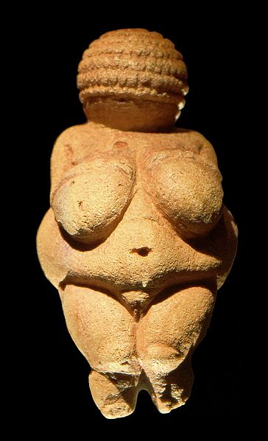
How is Woman, I similar to or different from these other representations of women?
LEFT TO RIGHT:
Venus von Willendorf paleolithic sculpture, image protected under Creative Commons by Oke; Willem de Kooning. Woman, I. 1950-52; Pinup Girl image protected under Creative Commons by Tor Kristensen
MoMA Abstract Expressionism
Notes:
Share this information with your students:
The hulking, wild-eyed subject draws upon an amalgam of female archetypes, from Paleolithic fertility goddesses to contemporary pin-up girls. Her stare and ferocious grin are heightened by de Kooning’s aggressive brushwork and frantic paint application. Combining voluptuousness and menace, Woman, I might reflect the age-old cultural ambivalence between reverence for and fear of the power of the feminine. Others have critiqued de Kooning’s representation of women as ugly and crude, treating the female body as an object.

Slide 10
Jackson Pollock. One: Number 31, 1950. 1950
MoMA Abstract Expressionism
Notes:
Jackson Pollock. One: Number 31, 1950. 1950
Oil and enamel paint on canvas, 8' 10" x 17' 5 5/8" (269.5 x 530.8 cm). Sidney and Harriet Janis Collection Fund (by exchange). © 2013 Pollock-Krasner Foundation / Artists Rights Society (ARS), New York

Slide 11
Helen Frankenthaler. Jacob’s Ladder. 1928
MoMA Abstract Expressionism
Notes:
Helen Frankenthaler. Jacob’s Ladder. 1928
Oil on canvas, 9' 5 3/8" x 69 7/8" (287.9 x 177.5 cm). Gift of Hyman N. Glickstein. © 2013 Helen Frankenthaler / Artists Rights Society (ARS), New York

Slide 12
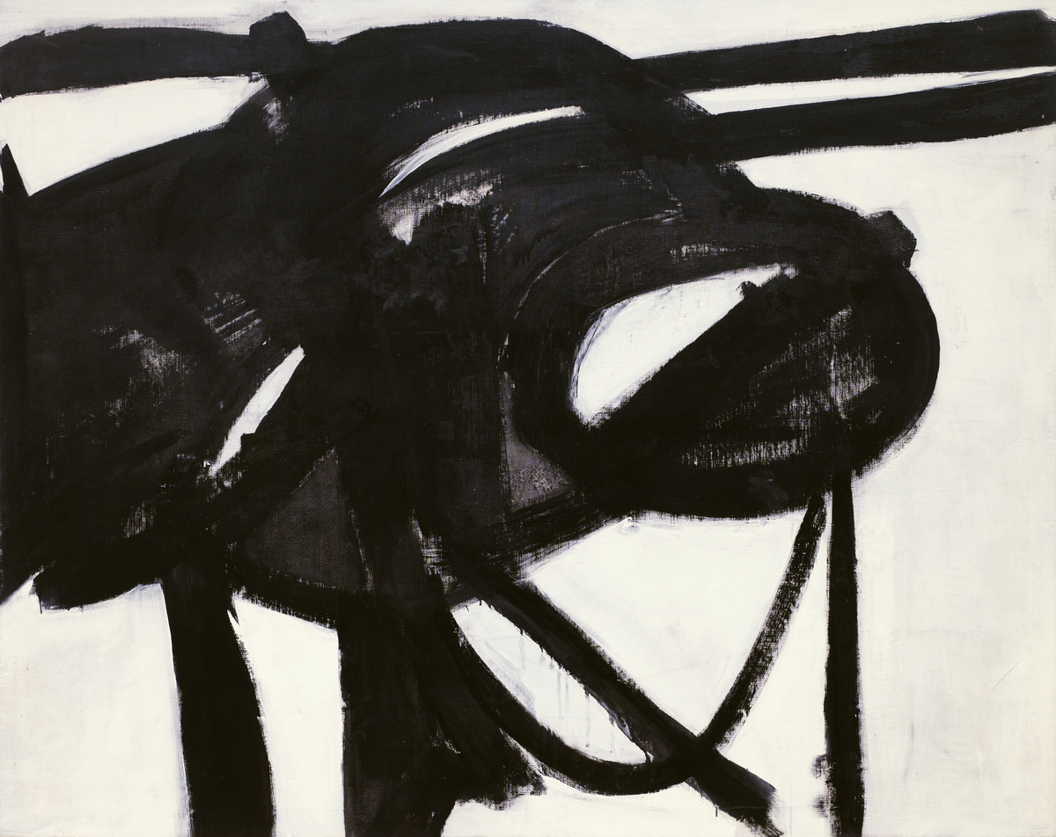
Franz Kline. Chief. 1950
MoMA Abstract Expressionism
Notes:
Share this information with your students:
The dynamic curves and slashes of Chief may seem spontaneous, but this painting, like many of his so-called action paintings, was likely carefully reproduced from a preliminary study. The painting’s title refers to the name of a train that passed through his childhood hometown in Pennsylvania.
Franz Kline. Chief. 1950
Oil on canvas, 58 3/8" x 6' 1 1/2" (148.3 x 186.7 cm). Gift of Mr. and Mrs. David M. Solinger. © 2013 The Franz Kline Estate / Artists Rights Society (ARS), New York

Slide 13
Ad Reinhardt. Abstract Painting. 1963
MoMA Abstract Expressionism
Notes:
Share this information with your students:
At first glance, Abstract Painting may appear to be a monochromatic black canvas, but it actually consists of a three-by-three grid with squares varying in shades of black. To create the work, Reinhardt mixed black oil paint with small amounts of red, green, or blue, and allowed the paint to sit for several weeks in order to separate the pigment from the solvent. He would then pour out the solvent and use the leftover, concentrated paint in order to apply a completely smooth matte surface that left no trace of the artist’s brush.
Ad Reinhardt. Abstract Painting. 1963
Oil on canvas, 60 x 60" (152.4 x 152.4 cm). Gift of Mrs. Morton J. Hornick. © 2013 Estate of Ad Reinhardt / Artists Rights Society (ARS), New York

Slide 14
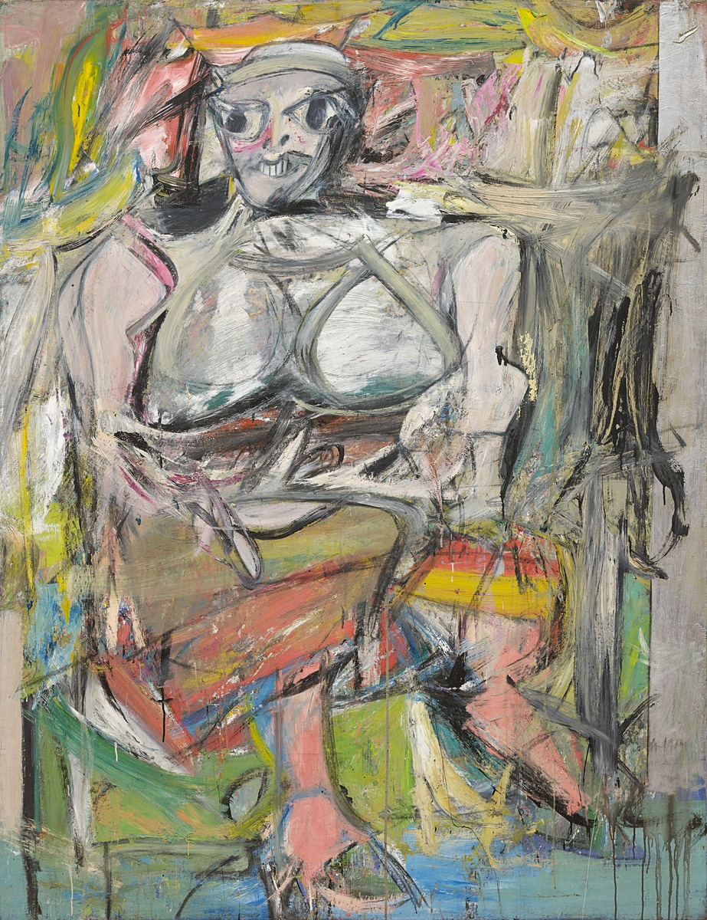
Willem De Kooning. Woman, I. 1950 – 52
MoMA Abstract Expressionism
Notes:
Willem De Kooning. Woman, I. 1950 – 52
Oil on canvas, 6' 3 7/8" x 58" (192.7 x 147.3 cm). Purchase. © 2013 The Willem de Kooning Foundation / Artists Rights Society (ARS), New York

Slide 15
Barnett Newman. The Voice. 1950
MoMA Abstract Expressionism
Notes:
Share this information with your students:
Barnett Newman is best known for painting vast fields of solid color interrupted by “zips,” or thin, vertical stripes. To create the painting, Newman applied an thin, even layer of egg tempera and enamel and then used masking tape to delineate the edges of the zips. Newman intended for his paintings to be viewed from only a few feet away, allowing for the monumental scale of the canvas to engulf the viewer.
Barnett Newman. The Voice. 1950
Egg tempera and enamel on canvas, 8' 1/8" x 8' 9 1/2" (244.1 x 268 cm). The Sidney and Harriet Janis Collection. © 2013 Barnett Newman Foundation / Artists Rights Society (ARS), New York

