Slide 1
The Power of Open Educational Resources
David Wiley, PhD
@opencontent

Slide 3
Unless otherwise noted this presentation is licensed CC BY 4.0

Slide 4
education

Slide 5
education =

Slide 6
education = sharing

Slide 7
sharing

Slide 8
what you know

Slide 9
sharing

Slide 10
feedback

Slide 11
sharing

Slide 12
encouragement

Slide 13
sharing

Slide 14
passion

Slide 15
sharing

Slide 16
yourself

Slide 17
“internet”

Slide 18
 | Handwriting | Printing Press | Internet
Copying a book | $1000s per copy | $1s per copy | $0.0001s per copy
Distributing a book | $1000s per copy | $1s per copy | $0.0001s per copy

Slide 19
unprecedented capacity

Slide 20
sharing

Slide 21
education = sharing

Slide 22
unprecedented capacity

Slide 23
education

Slide 24
except, it doesn’t

Slide 25
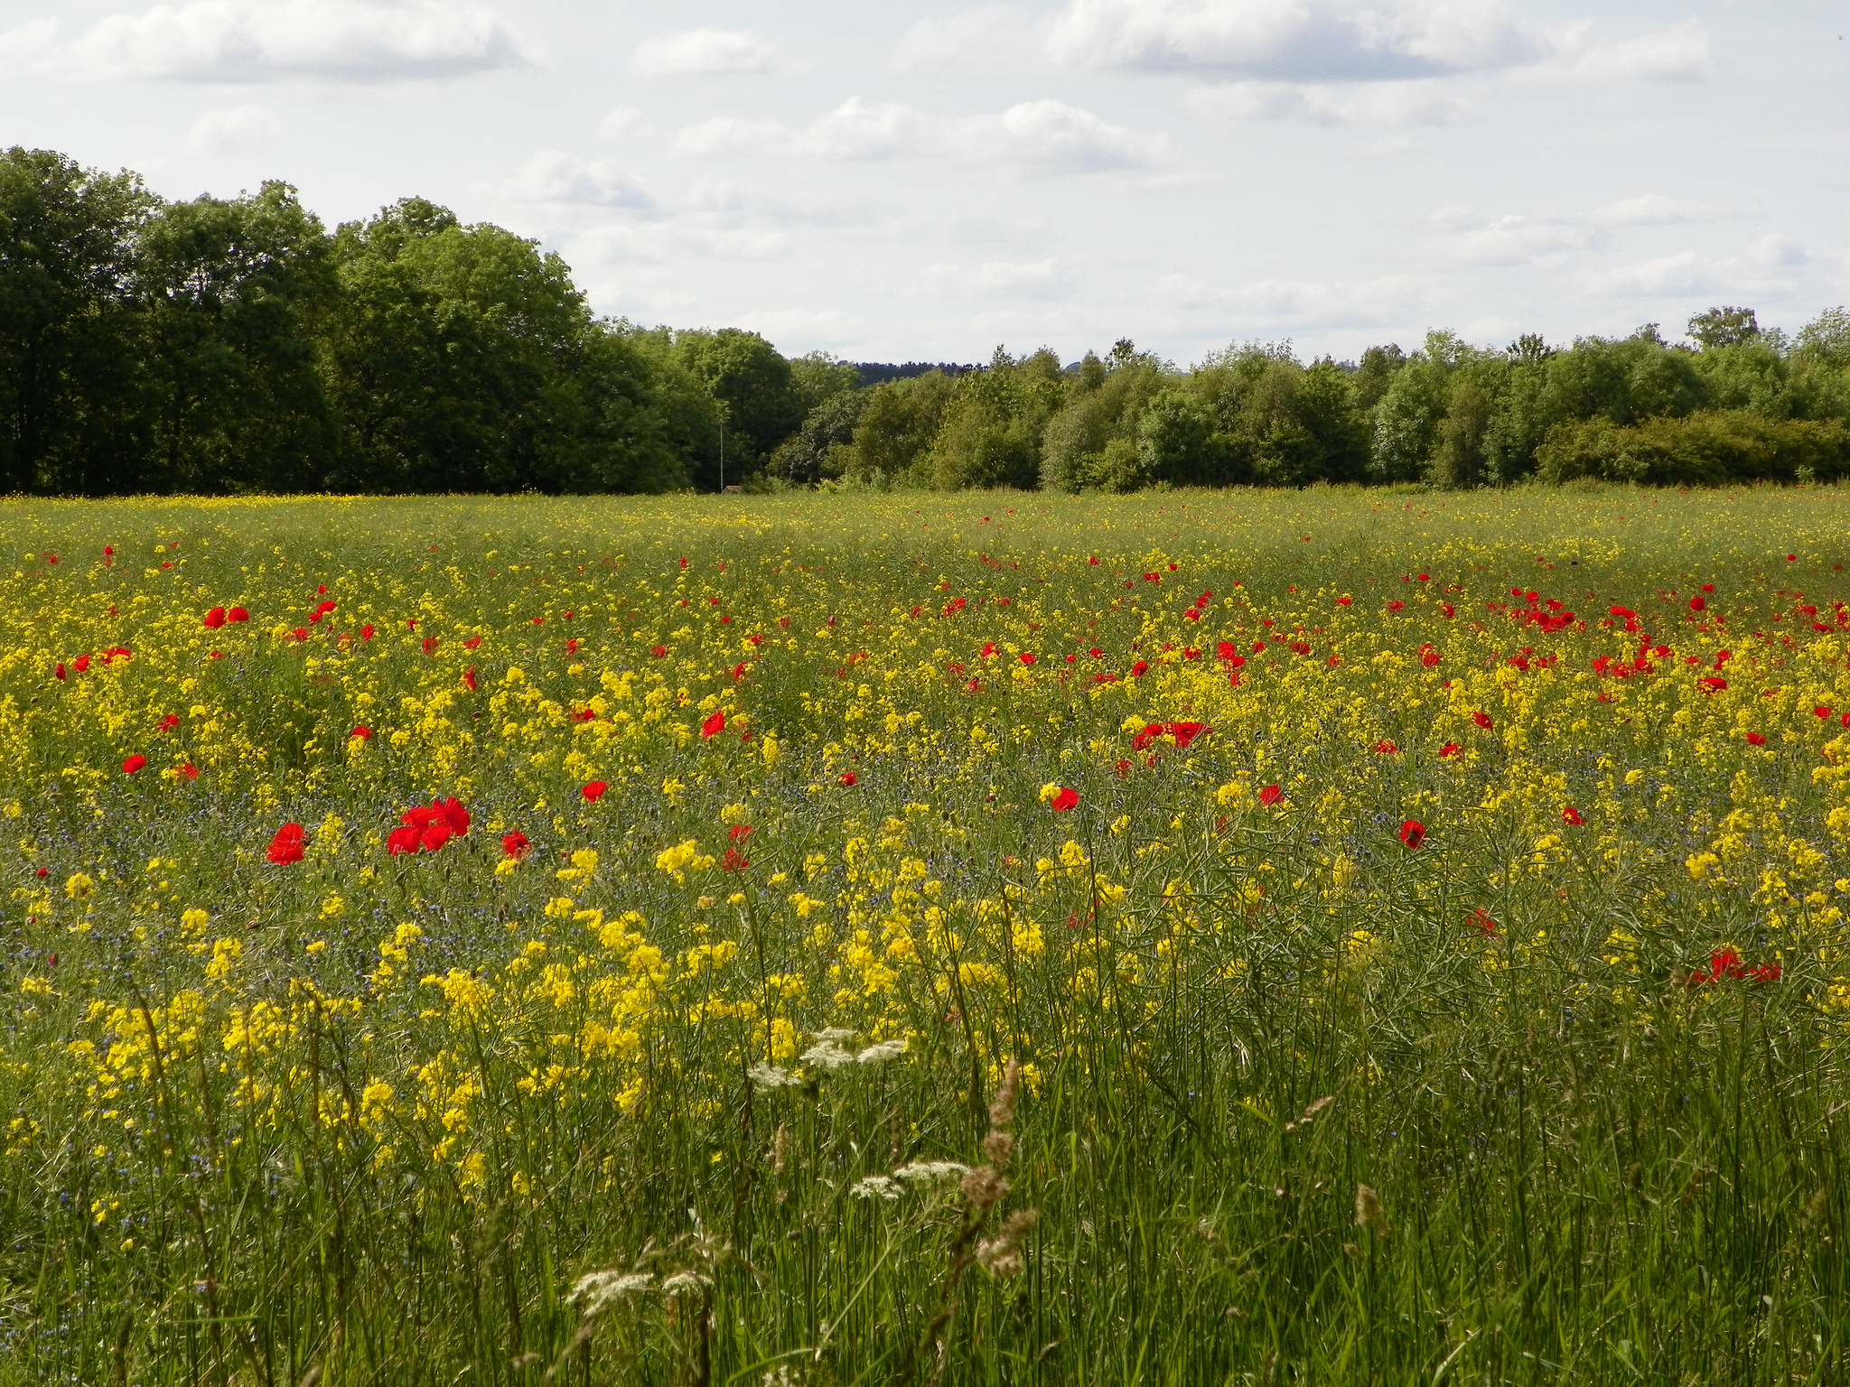
Notes:
CC BY NC SA photo https://www.flickr.com/photos/37177488@N06/8581162431

Slide 26
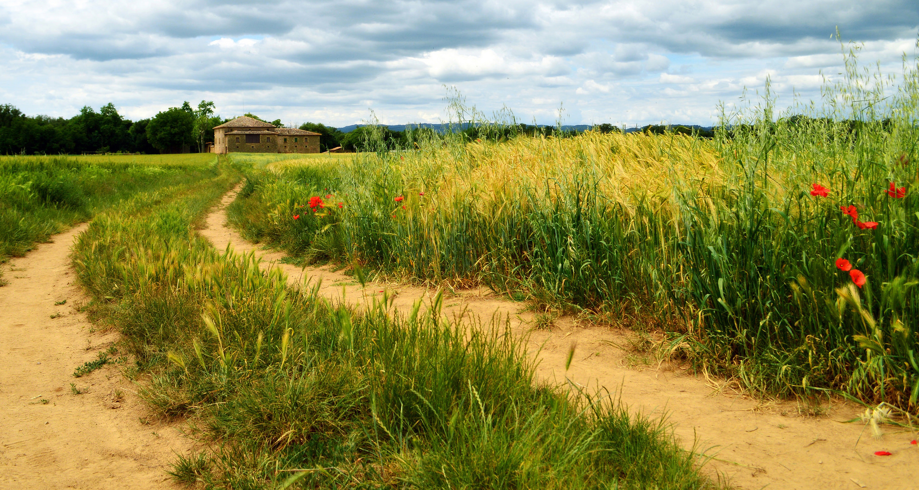
Notes:
https://www.flickr.com/photos/marinadelcastell/14243957036/in/photostream/

Slide 27
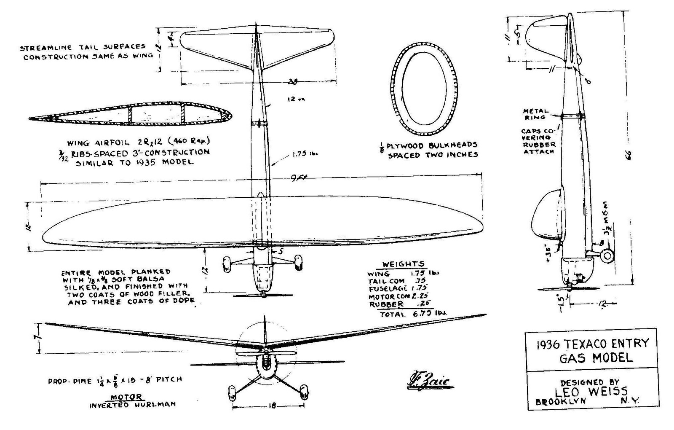
Notes:
CC BY Photo from https://www.flickr.com/photos/3th_summer_of_love_2012/15644049617

Slide 28
Notes:
CC BY Photo from https://www.flickr.com/photos/archangel12/6775428854

Slide 29
Notes:
https://www.flickr.com/photos/donhomer/7089013155 – CC BY

Slide 30
©

Slide 31
Copyright Regulates | Handwriting | Printing Press | Internet
Copying a book | $1000s per copy | $1s per copy | $0.0001s per copy
Distributing a book | $1000s per copy | $1s per copy | $0.0001s per copy

Slide 32
Internet Enables
Copyright Forbids

Slide 33
Notes:
CC BY Photo from https://www.flickr.com/photos/archangel12/6775428854

Slide 34
Open Educational Resources
Notes:
CC BY image from https://www.flickr.com/photos/kretyen/2628104710

Slide 35
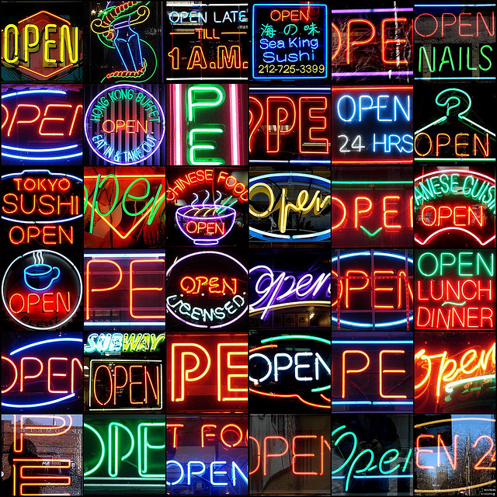
Which “open”?
Notes:
CC BY NC SA photo from https://www.flickr.com/photos/mag3737/1914076277

Slide 36
open ≈ free
Notes:
The ENTIRE INTERNET is free

Slide 37
free is assumed online

Slide 38
open = free + permissions

Slide 39
Free
Open

Slide 40
Open
1. Free and unfettered access
2. Perpetual, irrevocable 5R permissions

Slide 41
The 5Rs
Reuse
Use in a wide range of ways
Revise
Adapt, modify, and improve
Remix
Share with others
Combine two or more
Redistribute
Retain
Make and own a copy

Slide 43
retain is fundamental

Slide 44
retain is prerequisite to revise and remix

Slide 45
The 5Rs
Reuse
Use in a wide range of ways
Revise
Adapt, modify, and improve
Remix
Share with others
Combine two or more
Redistribute
Retain
Make and own a copy

Slide 46
Open Educational Resources
1. Free and unfettered access
2. Perpetual, irrevocable 5R permissions

Slide 47
“Faux-pen”
1. Free (possibly gated) access
2. All rights reserved (or stronger)

Slide 48
traditionally © materials + internet

Slide 49
Notes:
CC BY Photo from https://www.flickr.com/photos/archangel12/6775428854

Slide 50
openly licensed materials + internet

Slide 51
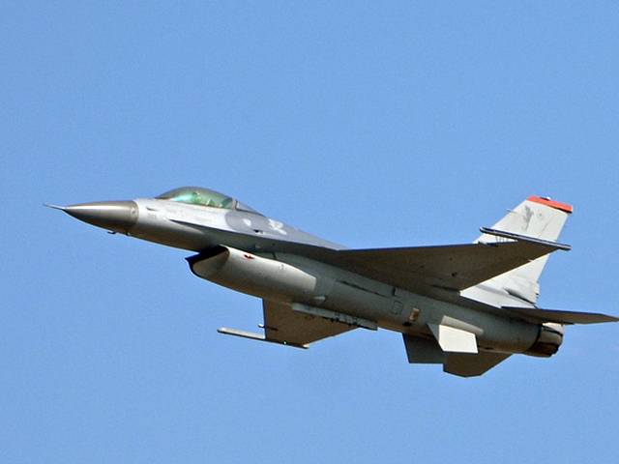
Notes:
CC BY Photo from https://www.flickr.com/photos/fotoecke/6302139020

Slide 52
Internet Enables
OER
Permits

Slide 53
OER Examples
Full courses, complete textbooks, chapters, modules, videos, simulations, assessments, syllabi, etc.

Slide 54
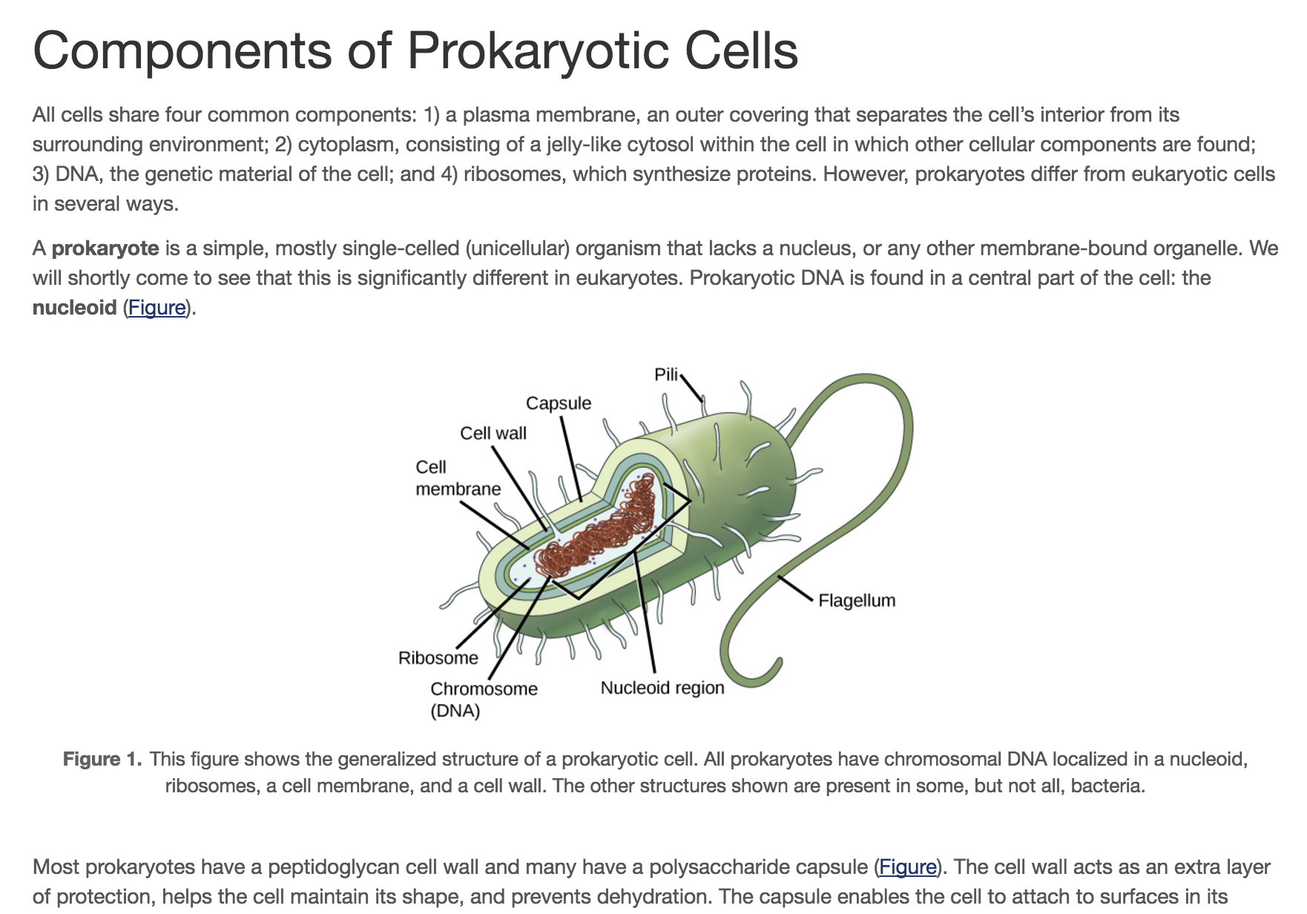

Slide 55
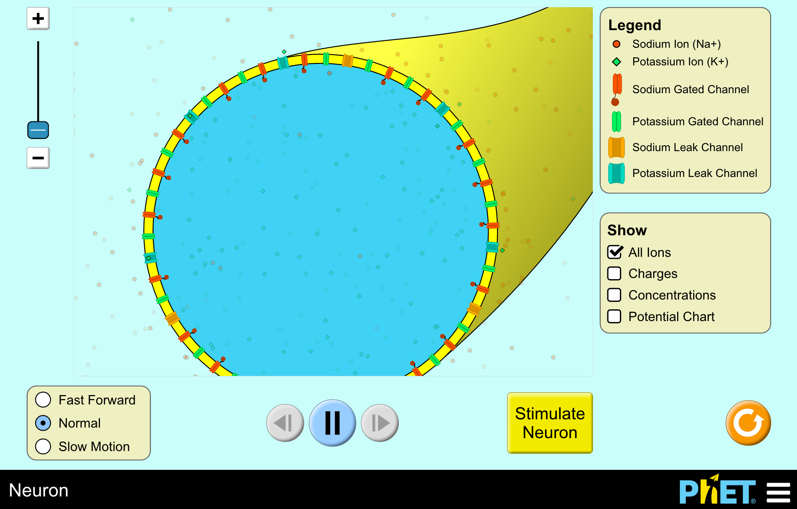

Slide 56
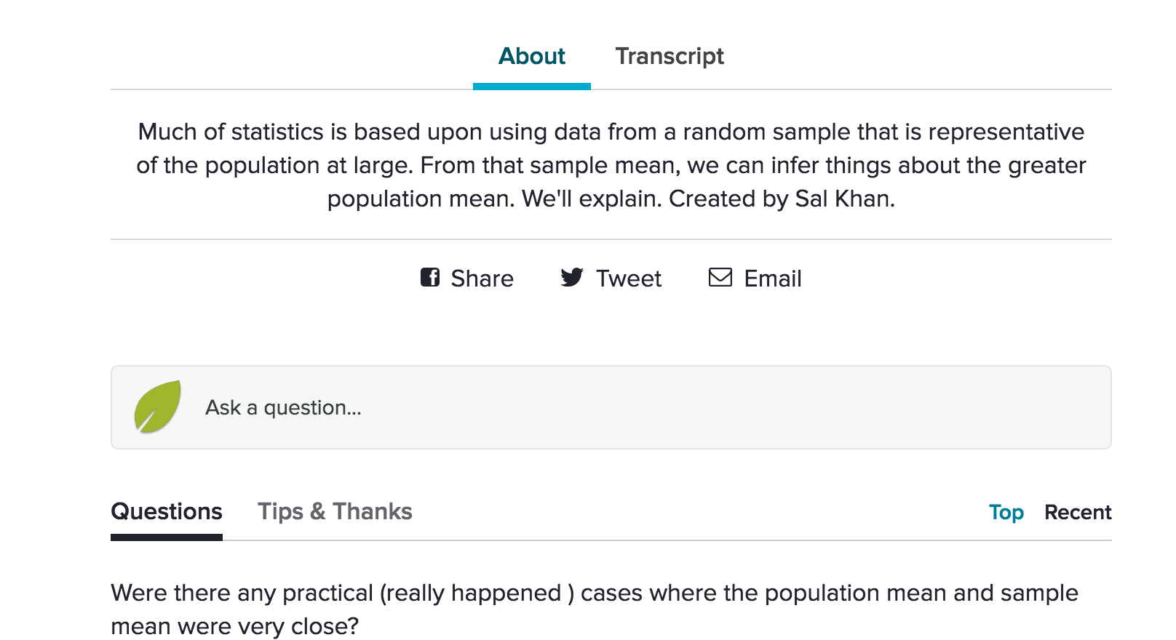

Slide 58
OER Adoption
Replacing whatever was previously in the “Required Materials” section of your syllabus with OER

Slide 59
High Impact OER Adoption
Adoption that:
Improves affordability,
Improves student success,
Invigorates pedagogy, and
Does it at scale

Slide 60
High Impact OER Adoption
Adoption that:
Improves affordability,
Improves student success,
Invigorates pedagogy, and
Does it at scale

Slide 61
Notes:
Copyrighted image from http://www.utpteachingculture.com/wp-content/uploads/2013/03/Textbook-ecard-1.jpg

Slide 62
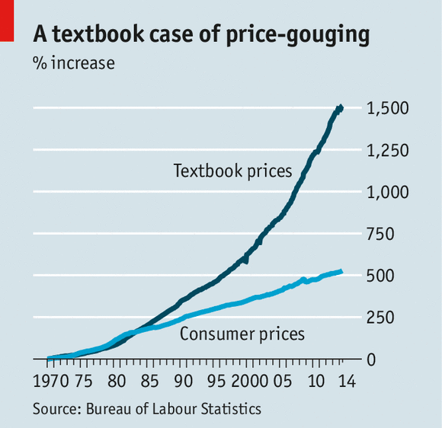
Notes:
Copyrighted graph reproduced from http://www.economist.com/news/united-states/21612200-its-economics-101-why-textbooks-cost-so-much

Slide 63
Textbook Pricing in Context
One Month Access to… | Costs…
Netflix – 20k Movies / TV Episodes | $7.99 / month
Spotify – 15M Songs | $9.99 / month
VitalSource – 1 Biology Textbook | $28.37 / month

Slide 64
A Wizard of Earthsea
Studying from texts written in disappearing ink
Notes:
© Image from http://ekostories.com/2012/03/05/a-wizard-of-earthsea/rebecca-guay-a-wizard-of-earthsea/

Slide 65
“Disappearing Ink” Strategies
Buyback, rental, e-books
online subscriptions

Slide 66
The Academic Costs of Textbooks
35% take fewer courses
14% drop a course
10% withdraw from a course
23% go without textbooks
18% earn a poor grade
Notes:
http://www.openaccesstextbooks.org/pdf/2012_Florida_Student_Textbook_Survey.pdf

Slide 67
High Impact OER Adoption
Adoption that:
Improves affordability,
Improves student success,
Invigorates pedagogy, and
Does it at scale

Slide 68
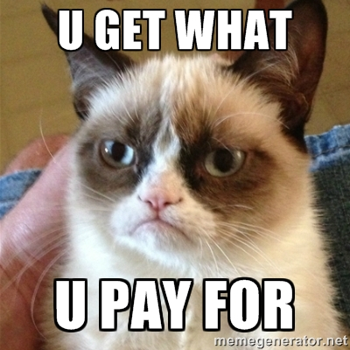

Slide 69
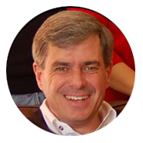
A Multi-Institutional Study of the Impact of Open Textbook Adoption on the Learning Outcomes of Post-secondary Students Fischer, Hilton, Robinson, and Wiley Journal of Computing in Higher Education (2015)

Slide 70
Participants
4,909 treatment
11,818 control
50 different undergraduate courses
130 teachers
10 institutions

Slide 71
Method
Quasi-experimental design with:
Propensity score matched groups
Dependent variables: Completion; C or Better; Credits Enrolled This Term; Credits Enrolled Next Term
Independent variable: Textbook condition
3 covariates: age, gender, and race

Slide 72
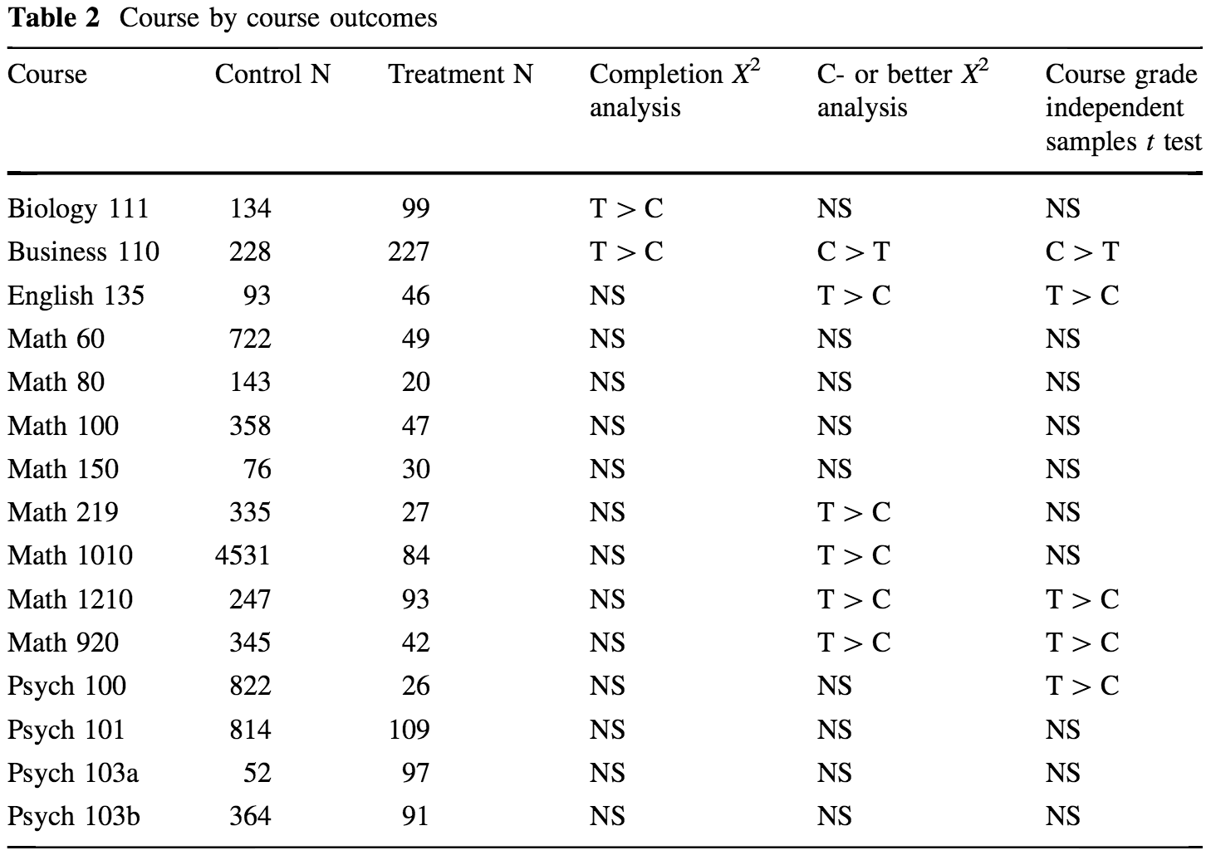
Journal of Computing in Higher Education (2015)
Notes:
http://link.springer.com/article/10.1007%2Fs12528-015-9101-x
16,000+ students

Slide 73
Credits Taken
Semester | OER Users | Others | Result
Fall | 13.29 | 11.14 | t (8101) = 27.81 p < .01
Winter | 10.71 | 9.16 | F(1, 6440) = 154.08, p <.01
Journal of Computing in Higher Education (2015)
Notes:
http://link.springer.com/article/10.1007%2Fs12528-015-9101-x

Slide 74
Improving Course Throughput Rates and Open Educational Resources: Results from the Z Degree Program at Tidewater Community College Hilton, Fischer, Wiley, and Williams Accepted International Review of Research in Open and Distance Learning

Slide 75
Course Throughput Rate
Students
Drop Deadline
Withdraw Deadline
Final Grade
IRRODL (in press)

Slide 76
Commercial vs OER
(Face to Face)
Drop
2.3% | 1.8%
Withdraw
9.9% | 8.1%
C or Better
68% | 74%
CTR
60% | 66%
IRRODL (in press)
Notes:
30,013 vs 1175

Slide 77
Commercial vs OER
(Online)
Drop
4.0% | 1.4%
Withdraw
13.7% | 13.1%
C or Better
66% | 70%
CTR
54% | 60%
IRRODL (in press)
Notes:
3333 vs 703

Slide 78
The Tidewater Z-Degree and the INTRO Model for Sustaining OER Adoption Wiley, Hilton, Williams, and DeMarte Educational Policy Analysis Archives (2016)

Slide 79
INcreased Tuition Revenue (Open)
182 * .89 * $164.35 (in-state) * 3
+ 182 * .11 * $358.95 (out-of-state) * 3
$101,042 INTRO annually
Education Policy Analysis Archives (2016)
Notes:
http://epaa.asu.edu/ojs/article/view/1828

Slide 80
openedgroup.org/review
Notes:
CC BY ND photo https://www.flickr.com/photos/billselak/3086892145

Slide 81
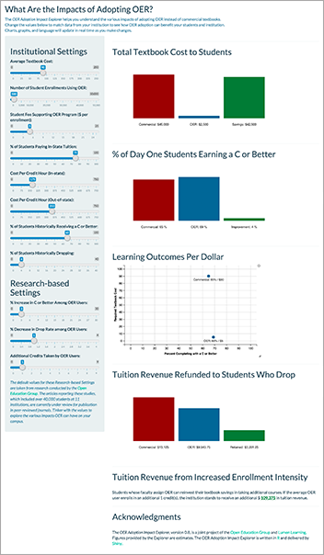
impact.lumenlearning.com

Slide 82
High Impact OER Adoption
Adoption that:
Improves affordability,
Improves student success,
Invigorates pedagogy, and
Does it at scale

Slide 83
“What does open allow me to do?”

Slide 84
Disposable Assignments
Students hate doing them
You hate grading them
Huge wasted opportunity

Slide 85
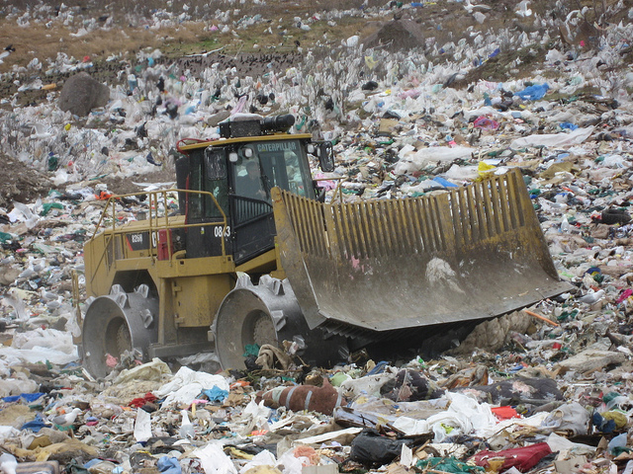
US college students spend approximately 40 million hours doing homework every year.
Notes:
Photo from https://flic.kr/p/8TzAA6, CC BY, Colin Delaney

Slide 86
Renewable Assignments
Students see value in doing them
You see value in grading them
The work adds value to the world

Slide 87
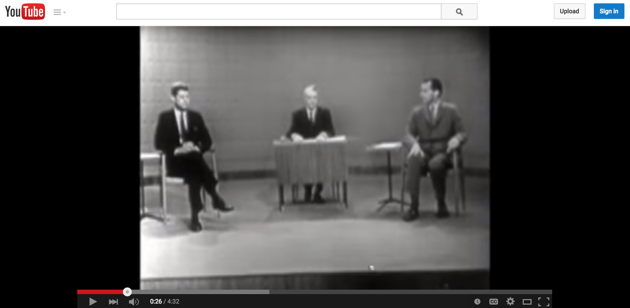
https://www.youtube.com/watch?v=AsFU3sAlPx4

Slide 88
PM4ID

Slide 89
Renewable Assignments
Are enabled by the open nature of OER

Slide 90
High Impact OER Adoption
Adoption that:
Improves affordability,
Improves student success,
Invigorates pedagogy, and
Does it at scale

Slide 91
OER-based Degrees
When elective and required courses adopt OER so a student can graduate without ever being asked to buy a textbook

Slide 92
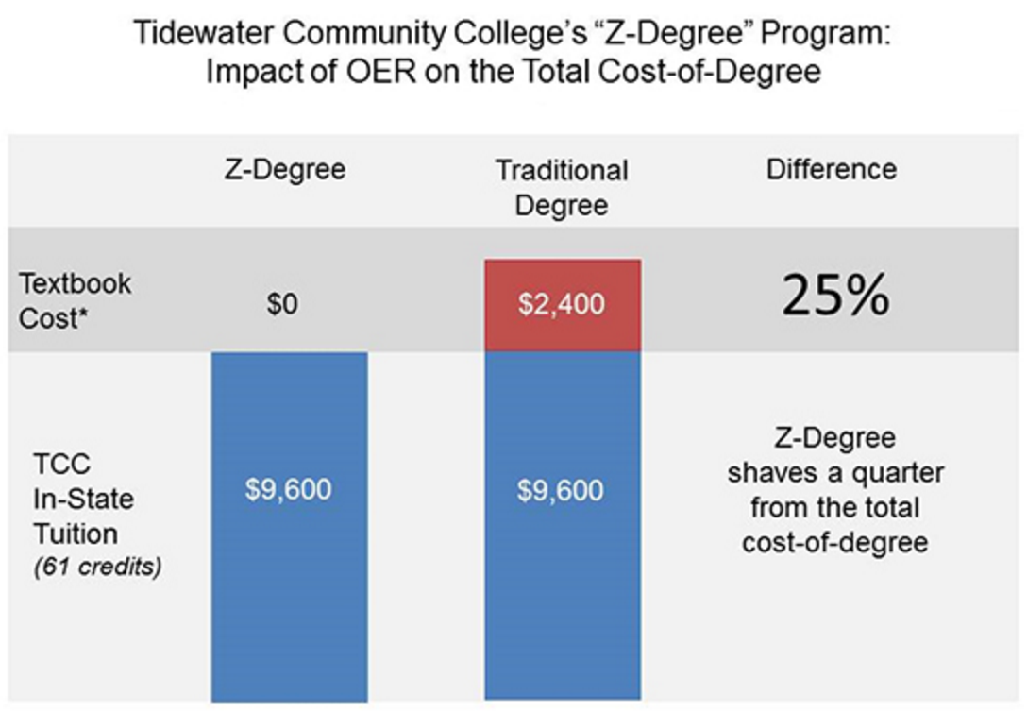
OER-based Degrees
Notes:
http://web.tcc.edu/academics/zdegree/

Slide 93
OER-based Degrees
Tidewater, NOVA (2013)
VCCS Zx23 – 23 colleges (2015)
Achieving the Dream 38 colleges (2016)
California – 25 colleges (2016)

Slide 94
High Impact OER Adoption Can:
Improve affordability,
Improve student success,
Invigorate pedagogy, and
Do it at scale

Slide 95
OER Office Hours
http://lumenlearning.com/office-hours/

Slide 96
Discussion
@opencontent
david@lumenlearning.com

