Slide 1
Scholarly States & Stakes:
The Open, the Closed, and the Fair
Jill Cirasella
jcirasella@gc.cuny.edu
@jillasella
bit.ly/OpenScholarshipPratt

Slide 2
Act I: Scholarly Publishing Whirlwind Tour

Slide 3
How Do You Find the Scholarly Works You Need?

Slide 4
Where Do Scholars Publish?
Lots of venues!
☑ scholarly journals
☑ magazines
☑ newspapers
☑ books

Slide 5
Where Do Scholars Publish?
Today’s focus:
☑ scholarly journals
☒ magazines
☒ newspapers
☒ books
What’s the difference? Whether or not author gets paid.

Slide 6
Accessing Journal Articles: Traditionally
From your library’s wallet:
Print journals
E-journals / databases
Interlibrary loan
From your wallet:
Personal subscriptions
Pay per article

Slide 7
Accessing Journal Articles: Increasingly
Discovery via free online tools...
Google / Google Scholar
...linking to cost-free access:
Articles freely available on journal websites
Articles posted to repositories
Articles posted to author websites
Articles posted to academic social networks (Academia.edu, ResearchGate)
Articles on pirate sites

Slide 8
Why? Two Kinds of Journals
#1: Toll Access Journals
Traditional subscription-based journals.
Many also sell individual articles.
Most toll access journals require authors
to transfer copyright to the journal.

Slide 9
Why? Two Kinds of Journals
#2: Open Access Journals (“Gold OA”)
Journals that automatically and immediately make
their articles available online to all at no cost.
Most gold OA journals do not take copyright.
They usually use Creative Commons licenses instead.

Slide 10
Another Journal Flavor
Journals that Let Authors Share (“Green OA”)
Journals (toll access or open access) that allow authors
to post (“self-archive”) their articles in OA repositories.
Most “green” toll access journals do take copyright,
but they “give back” some rights to the author.

Slide 11
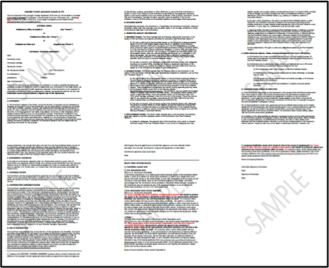
Is Self-Archiving Allowed? Ugh...
Source:
http://bit.ly/wiley_copyright

Slide 12
Is Self-Archiving Allowed? Easier!
SHERPA/RoMEO
http://www.sherpa.ac.uk/romeo/
Search by journal/publisher to learn
its copyright and self-archiving policies

Slide 13
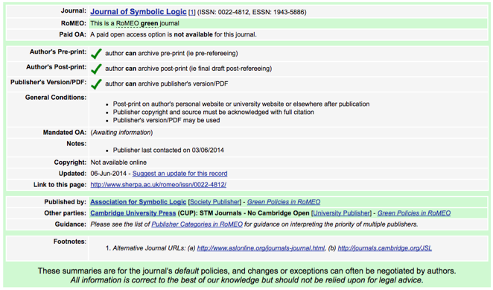
Very Good...

Slide 14
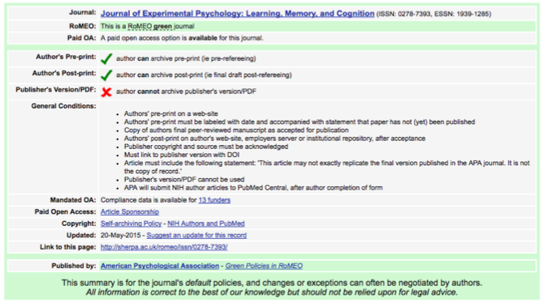
Quite Good...

Slide 15
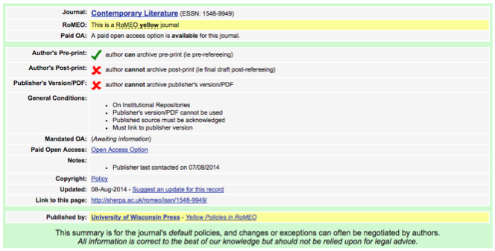
Not Great...

Slide 16
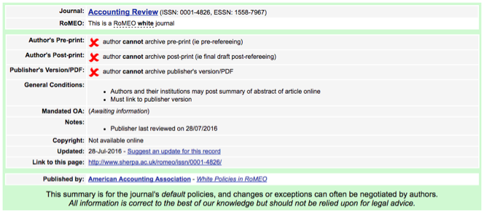
Very Bad...

Slide 17
Prevalence of Permission?
As of April 2019, SHERPA/RoMEO covers 2561 publishers.
81% allow some form of self-archiving.
(Also, some authors negotiate their contract before publication, ask for permission to post after the publication, or knowingly or unknowingly violate their contract.)

Slide 18
Creative Commons Licenses
Most OA journals use Creative Commons (CC) licenses,
which grant the public permission to use the work
in more ways than traditional copyright allows.
CC licenses also grant authors more rights than they’ve have
after signing a traditional copyright transfer agreement!

Slide 19
OA Journal Mythbusting
Reminder:
“Gold OA” means publishing with publishers
that automatically and immediately make
the work available online to all at no cost —
i.e., journals that are “born” open access.

Slide 20
Respectability of OA Journals?
OA = anyone can read the journal
OA ≠ anyone can publish in the journal
OA journals are real journals. Publishing in an OA journal is not self-publishing or vanity publishing!
OA journals earn respectability the same way other journals do: through the quality of their articles and the prominence of the people they attract as authors, editors, and peer reviewers.
A journal’s quality is independent of its openness. Some non-OA journals are better and more rigorously peer reviewed than others. Likewise, some OA journals are better and more rigorously peer reviewed than others.

Slide 21
Business Models
If OA journals are free to read, how do they cover costs?
There are many business models for OA journals, including:
Volunteers & institutional subsidies
Advertising
Fees for print or premium editions
Endowments & donations
Article publication charges (APCs)
Institutional memberships
A combination of the above

Slide 22
Publication Charges?!
Some OA journals have article processing charges (APCs).
(Some subscription-based journals charge fees too!)
But most OA journals do not charge APCs.
Ideally, APCs are not paid from researchers’ pockets:
Some institutions pay APCs for their employees.
Grants can be used to pay APCs.
Some journals waive APCs.

Slide 23
APCs ≠ Vanity Publishing
Some people worry:
Aren’t APCs tantamount to vanity publishing?
NO!
At reputable and honest journals, APCs have
no bearing whatsoever on whether an article is accepted.

Slide 24
What about Disreputable Journals?
So-Called “Predatory” or “Fake” Open Access Journals
unscrupulous, unserious, spamming, APC = acceptance
Why would anyone publish in a fake journal?
Some authors know what’s up and publish there anyway (due to rejections from other journals, job pressures to publish quickly and/or voluminously, etc.).
Some authors are duped into publishing there.

Slide 25
Don’t Be Fooled!
With a little due diligence and thoughtful evaluation, you can suss out fake and questionable journals.
Heard about lists? Forget the lists.
Think critically about journals!
Evaluate journals you’re reading.
Evaluate journals you’re thinking about submitting to.
Remember: Low-quality journals are not unique to OA publishing!
Think critically about all journals!

Slide 26
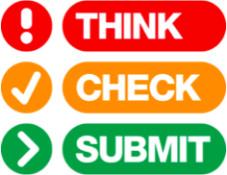
Think Critically
Think. Check. Submit.
thinkchecksubmit.org
Also: Open Access Journal Quality Indicators
http://bit.ly/OAindicators

Slide 27
Think Critically about All Journals
Think. Check. Submit.
thinkchecksubmit.org
Also: Open Access Journal Quality Indicators
http://bit.ly/OAindicators

Slide 28
“Pre-Approved” OA Journals
Directory of Open Access Journals
doaj.org
Browse or search 13,000+ open access journals
that have been vetted for transparency and quality control.
Most do not charge APCs.

Slide 29
Publication Charges?!

Slide 30
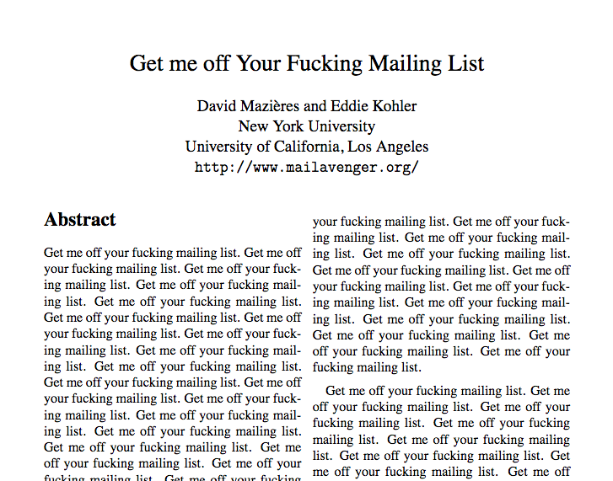
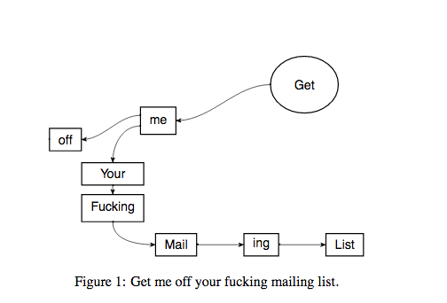
Be Skeptical of Solicitations
An actual article accepted by the International Journal of Advanced Computer Technology! (An irritated researcher submitted it after being repeatedly spammed by the journal.)
The “peer reviewer” called it “excellent”!
Read more.

Slide 31
Speaking of predation...

Slide 32
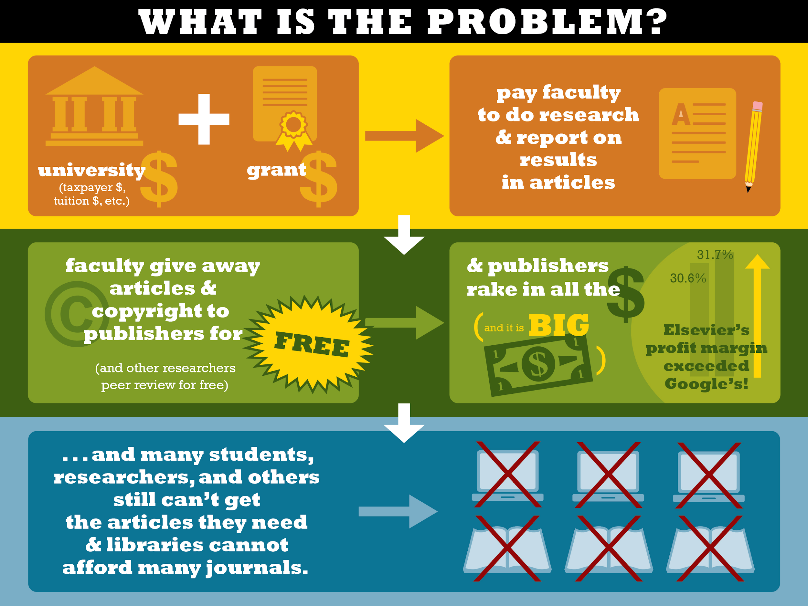
Consider This:
Content by Jill Cirasella / graphic design by Les LaRue, licensed under a Creative Commons Attribution-ShareAlike 3.0 Unported License

Slide 33
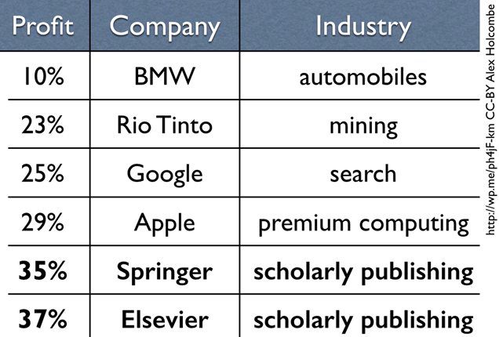
And This:

Slide 34
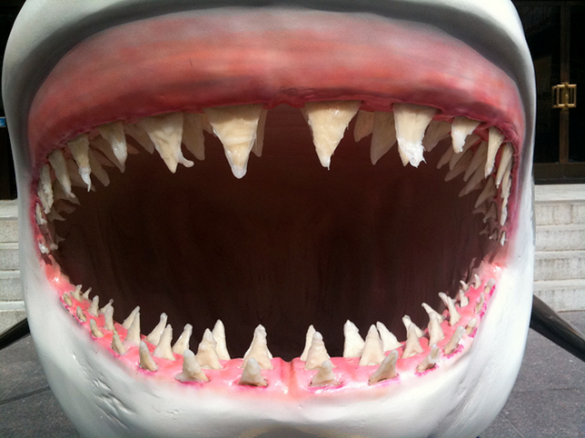
Who are the real predators?
Source: https://www.flickr.com/photos/liquidsunshine49/4747655198/

Slide 35
More Ways to Find Open Access Scholarly Literature

Slide 36
Google Scholar

Slide 37
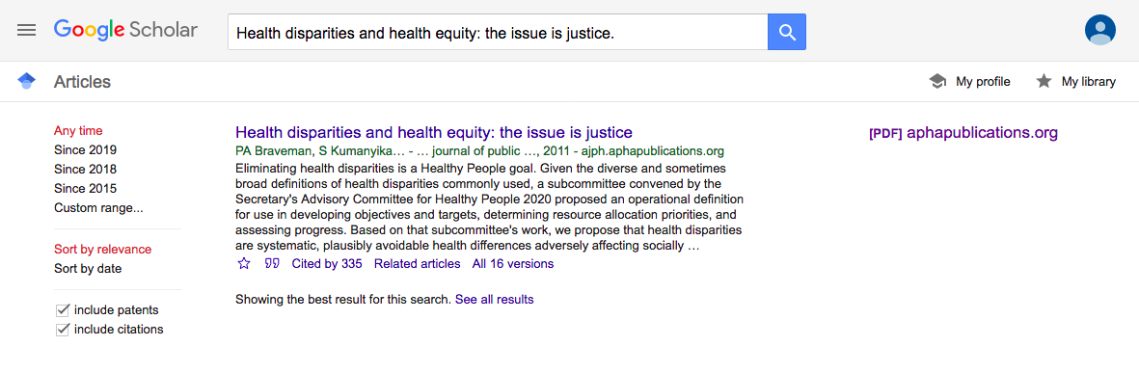
Google Scholar: Links to OA Versions
OA from publisher

Slide 38
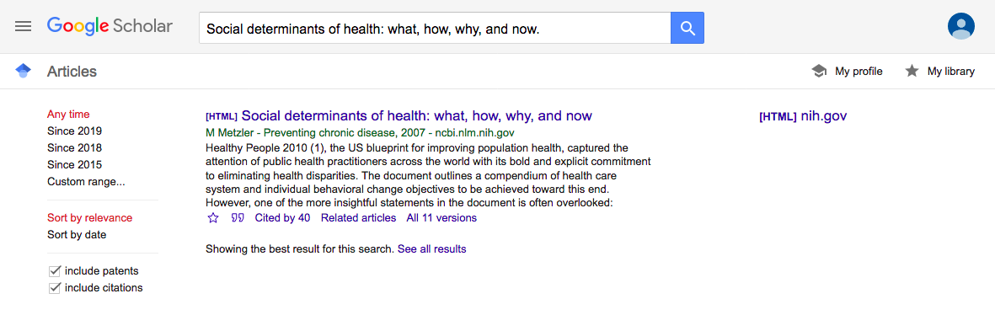
Google Scholar: Links to OA Versions
OA through PubMed Central

Slide 39
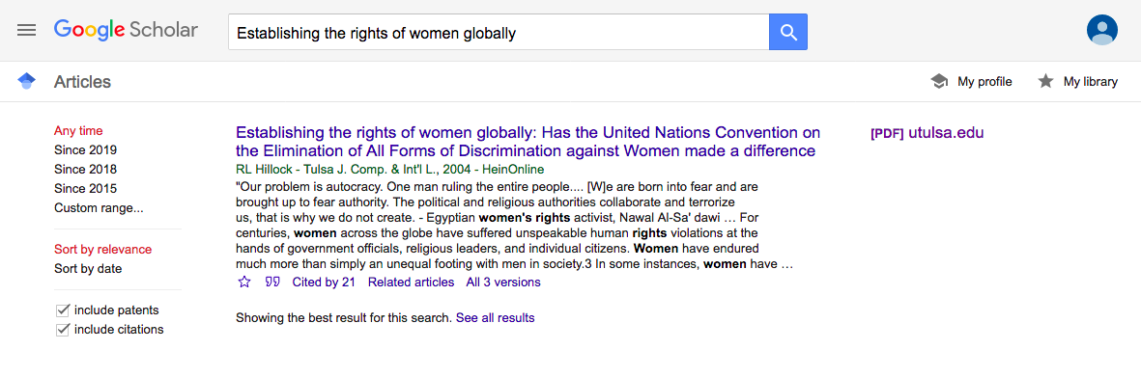
Google Scholar: Links to OA Versions
OA through author’s institutional repository

Slide 40
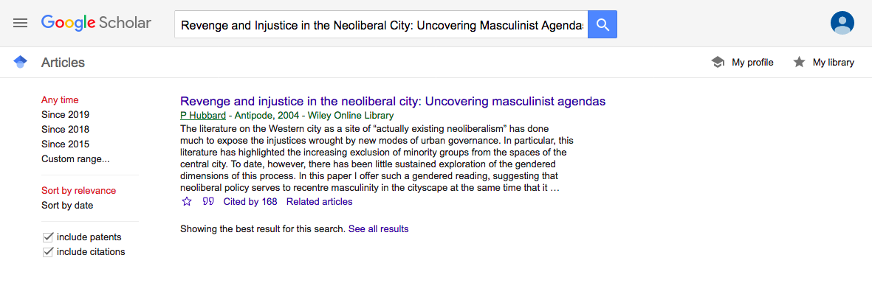
Google Scholar: No Luck?
No luck?

Slide 41
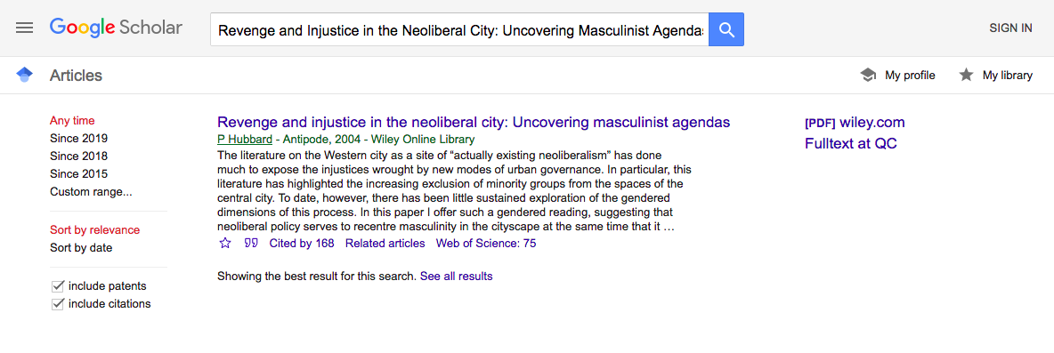
Google Scholar: Zero Cost through Library
Library Links
Use Google Scholar customized for your library!

Slide 42
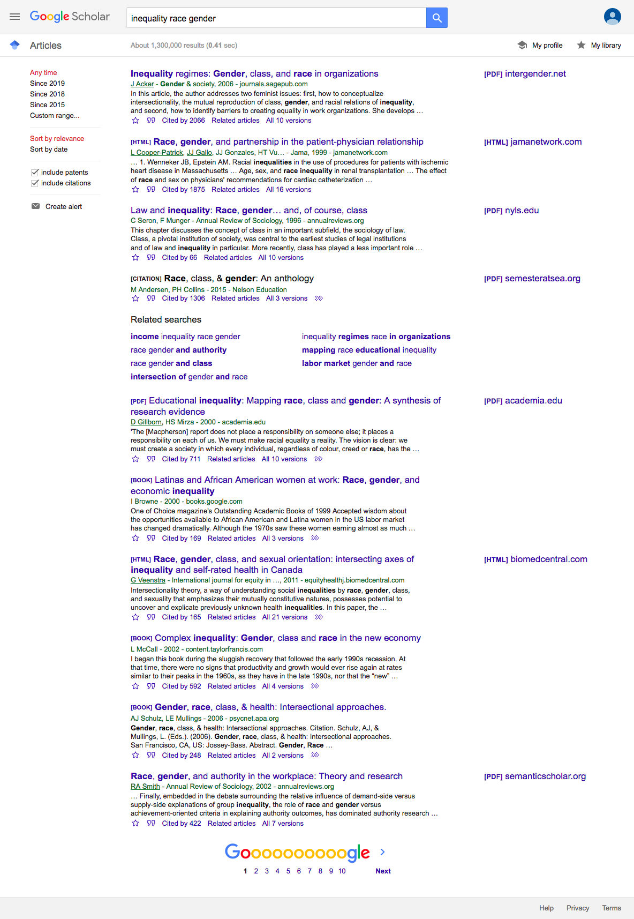
Google Scholar: Topic Searches

Slide 43
Unpaywall

Slide 44
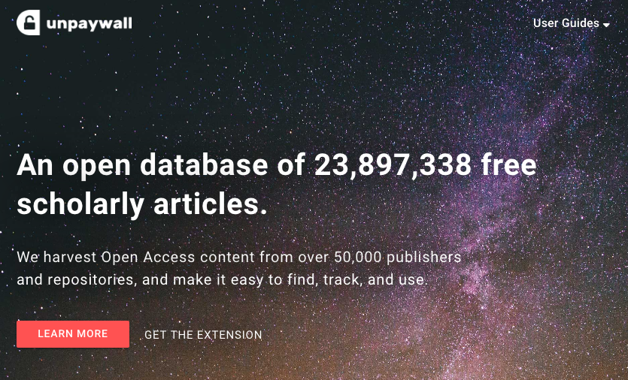
Unpaywall: Get the Extension

Slide 45
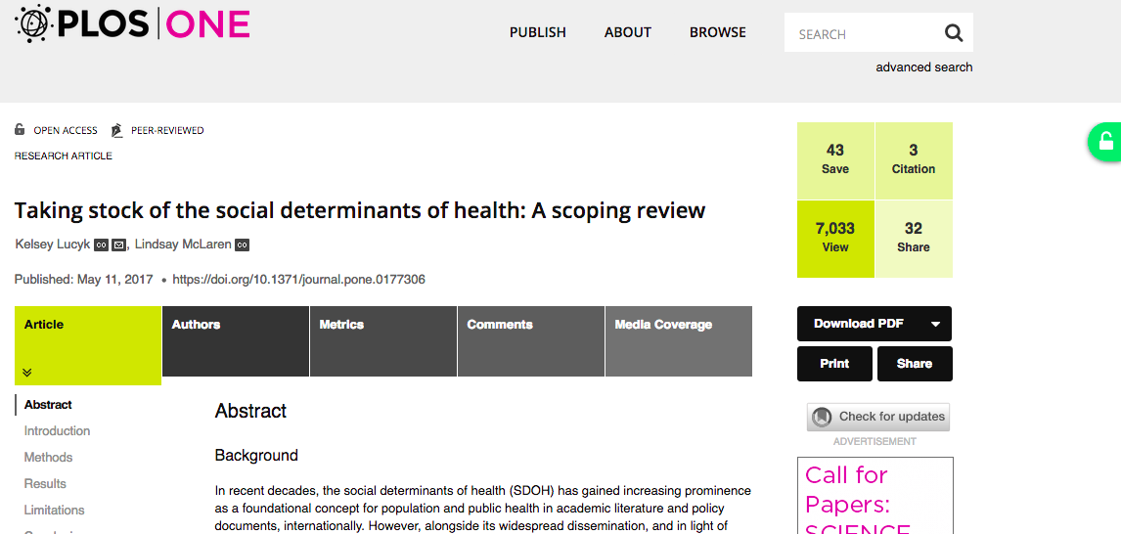
Unpaywall in Action

Slide 46
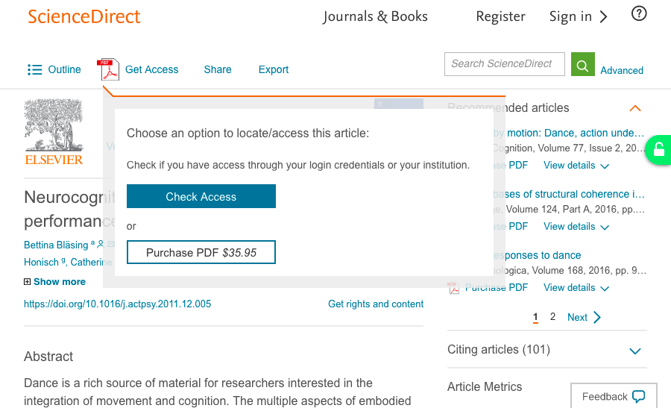
Unpaywall in Action

Slide 47
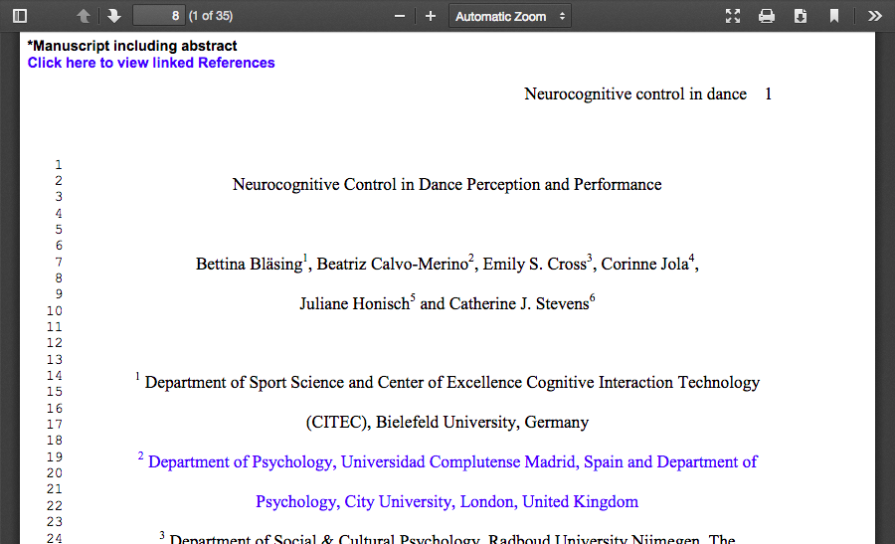
Unpaywall in Action
Notes:
Note that this is an AAM, not final formatted PDF

Slide 48
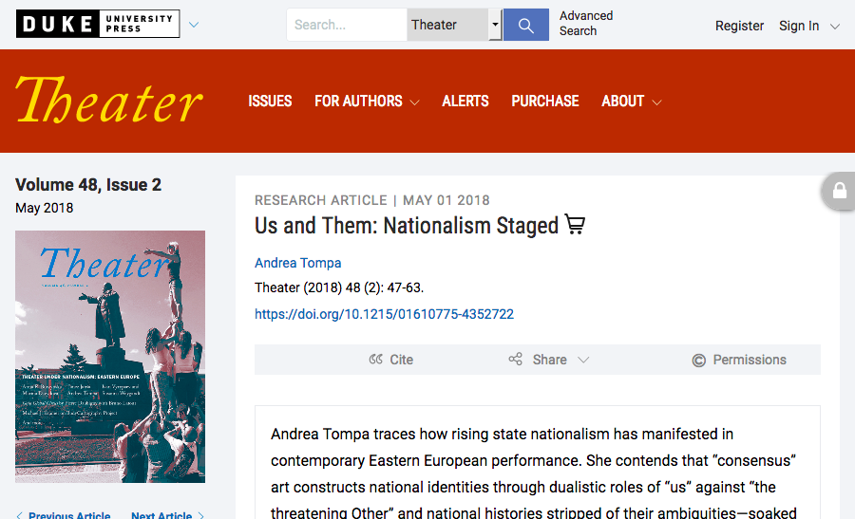
Unpaywall in Action: No Luck

Slide 49
Open Access Button

Slide 50
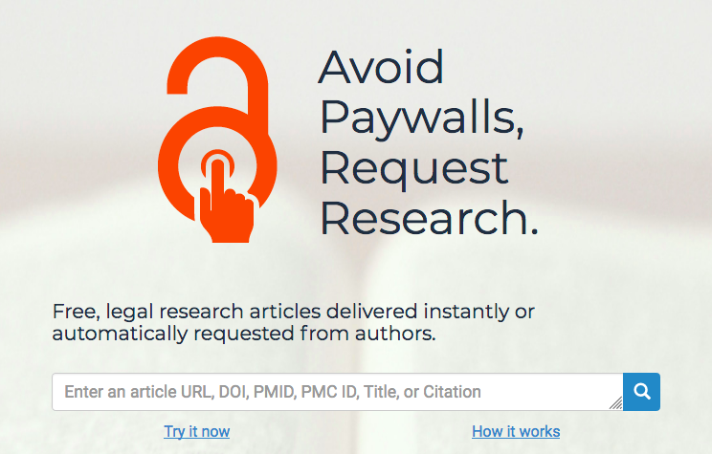
Open Access Button

Slide 51
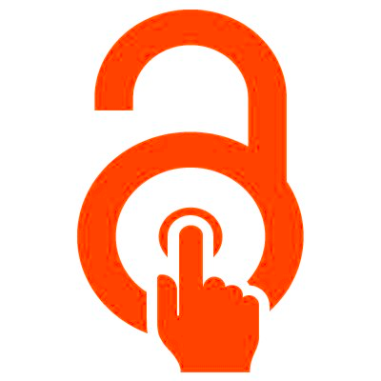
Open Access Button

Slide 52
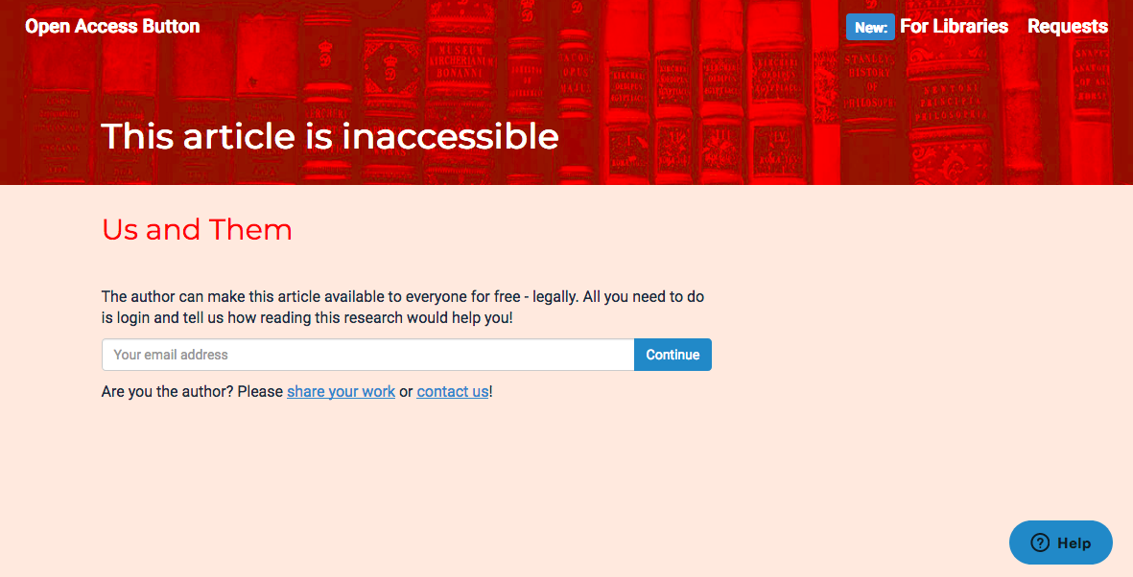
Open Access Button

Slide 53
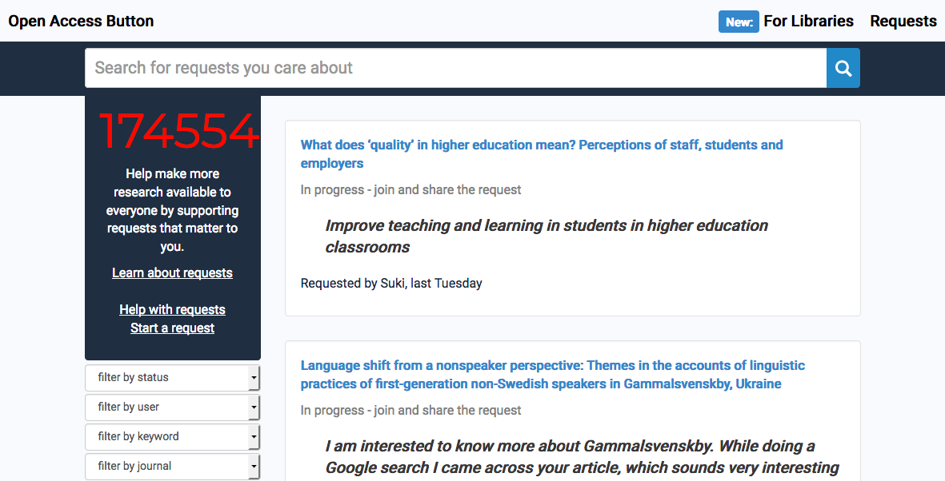
Open Access Button

Slide 54
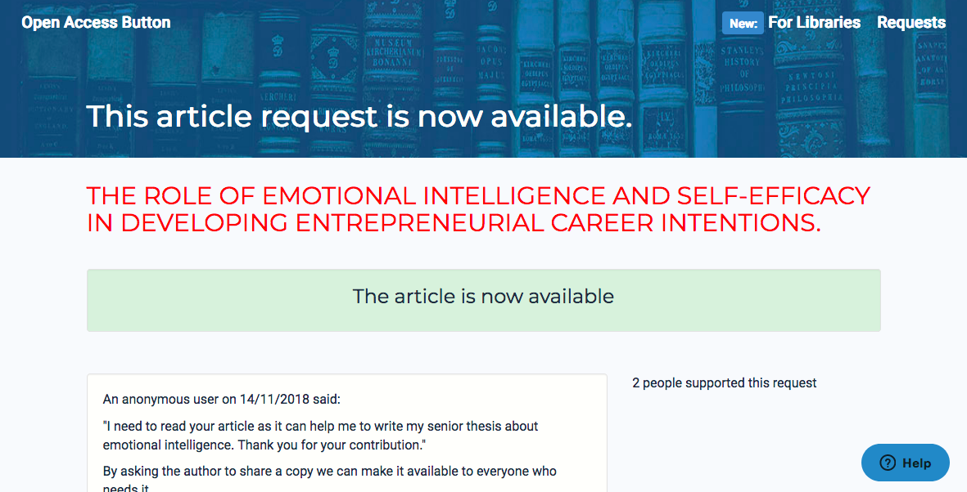
Open Access Button

Slide 55
Unpaywall Success Rate?
“We estimate that at least 28% of the scholarly literature is OA (19M in total) and that this proportion is growing, driven particularly by growth in Gold and Hybrid. The most recent year analyzed (2015) also has the highest percentage of OA (45%). Because of this growth, and the fact that readers disproportionately access newer articles, we find that Unpaywall users encounter OA quite frequently: 47% of articles they view are OA. Notably, the most common mechanism for OA is not Gold, Green, or Hybrid OA, but rather an under-discussed category we dub Bronze: articles made free-to-read on the publisher website, without an explicit Open license.”
— Piwowar, Priem, et al. https://peerj.com/articles/4375/

Slide 56
Where is posting generally allowed?
Institutional repositories: CUNY Academic Works, UC’s eScholarship, Harvard DASH, etc.
Disciplinary repositories: arXiv, SocArxiv, bioRxiv, PubMed Central, SSRN (Social Science Research Network), etc.
Open access via publisher (“gold” or “bronze” OA)
Authors’ personal or institutional websites

Slide 57
Where is posting generally NOT allowed?
Another person’s / institution’s website
Academic social networks: Academia.edu, ResearchGate
Pirate sites: Sci-Hub, etc.
Other random websites
Important: Copies on these sites may or may not be legal.
Notes:
Mention issues regarding takedown, impermanence

Slide 58
Intermission
Notes:
Mention issues regarding takedown, impermanence

Slide 59
Act II: Using Copyrighted Works for Digital Scholarship / Data Analysis
Notes:
Mention issues regarding takedown, impermanence

Slide 60
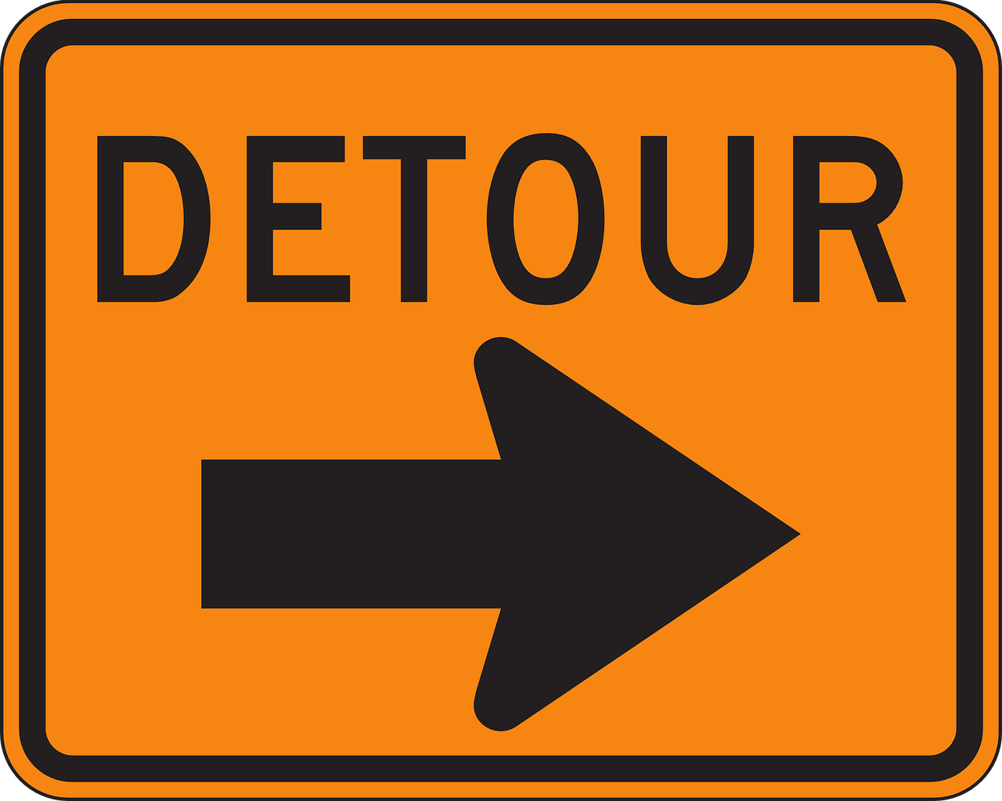
Notes:
Mention issues regarding takedown, impermanence

Slide 61
I am not a lawyer.

Slide 63
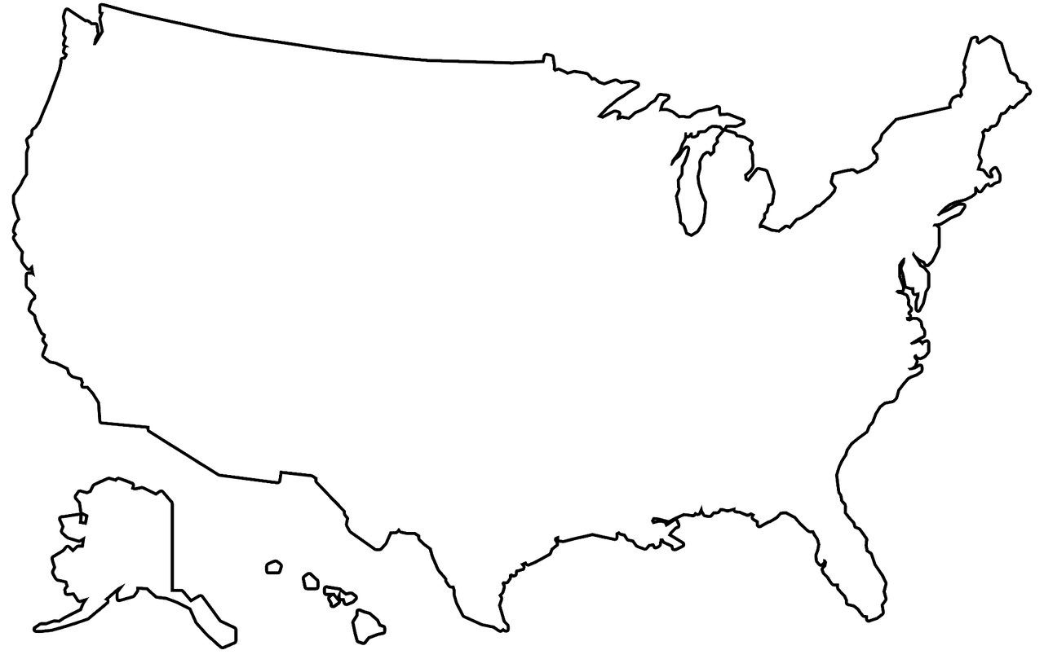

Slide 64
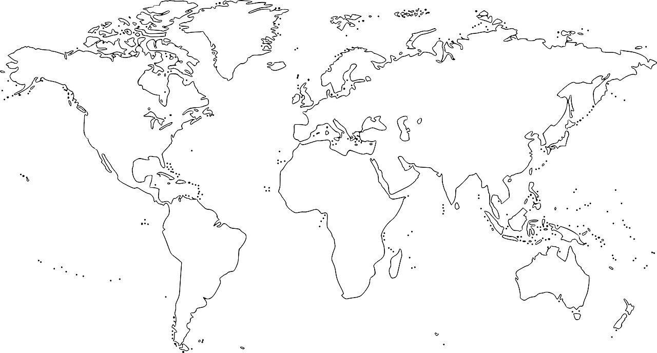
Why?
International copyright law can get very complex.

Slide 65
U.S. Copyright
17 U.S. Code § 106 https://www.law.cornell.edu/uscode/text/17/106
The copyright owner of a work has the exclusive rights to do and to authorize any of the following:
to reproduce the work in copies
to prepare derivative works based on the work
to distribute copies of the work
to perform the work publicly
to display the work publicly

Slide 66
Length of U.S. Copyright Protections
When does copyright protection begin?
As soon as a work is fixed in tangible form. (Publication not required. Copyright registration not required.)
How long does copyright protection last? For works created in or after 1978:
Individually authored works: life of the author + 70 years
Jointly authored works: life of last surviving author + 70 years
Works for hire, anonymous works, pseudonymous works: 95 years after publication, or 120 years after creation, whichever comes first

Slide 67
Length of U.S. Copyright Protections
What happens after copyright expires?
The work enters the public domain (i.e., belongs to the public).
No intellectual property laws apply.
Copyright violation vs. plagiarism?
Remember: Copyright (legal protection) is different from prohibitions on plagiarism (academic norms).
Plagiarism is always a violation of academic integrity, even after copyright expires. Cite all sources, including works in the public domain.

Slide 69
Defining “Open Access”
Public Access
free, online availability
Public Access + Open License
public access + right for anyone to reproduce, make derivative works, distribute, display, perform, etc.

Slide 72
Limitations on Exclusive Rights
Exemptions
Some allowed uses for libraries, people with disabilities, etc.
Uses That Are “Fair”
“Fair use” in United States and a few other countries. “Fair dealing” in Canada, UK, and many other countries.

Slide 73
Fair Use vs. Fair Dealing (Very, Very Roughly)
“Fair”
i.e., allowable, not infringing, not requiring permission
Fair Use
Determined case-by-case based on a four-factor analysis. Stay tuned!
Fair Dealing
In order to be fair, must be on enumerated list of fair purposes.

Slide 74
Fair Use
17 U.S. Code § 107 https://www.law.cornell.edu/uscode/text/17/107
“[T]he fair use of a copyrighted work . . . for purposes such as criticism, comment, news reporting, teaching (including multiple copies for classroom use), scholarship, or research, is not an infringement of copyright.”

Slide 75
Determining Fair Use
17 U.S. Code § 107 (cont’d)
“In determining whether the use made of a work in any particular case is a fair use the factors to be considered shall include—
the purpose and character of the use, including whether such use is of a commercial nature or is for nonprofit educational purposes;
the nature of the copyrighted work;
the amount and substantiality of the portion used in relation to the copyrighted work as a whole; and
the effect of the use upon the potential market for or value of the copyrighted work.”

Slide 76
Most Important Factor?
Every Case Is Different
There is no bright-line test for fair use. All four factors must always be considered and weighed. Nevertheless…
The 4th factor (market effect of the use) used to carry the most weight. Since Campbell v. Acuff-Rose (stay tuned!), it has been eclipsed by the 1st factor (purpose and character of the use).

Slide 77
Let’s look again...

Slide 78
Fair Use
17 U.S. Code § 107 https://www.law.cornell.edu/uscode/text/17/107
“[T]he fair use of a copyrighted work . . . for purposes SUCH AS criticism, comment, news reporting, teaching (including multiple copies for classroom use), scholarship, or research, is not an infringement of copyright.”

Slide 79
Determining Fair Use
17 U.S. Code § 107 (cont’d)
“In determining whether the use made of a work in any particular case is a fair use the factors to be considered shall INCLUDE—
the purpose and character of the use, INCLUDING whether such use is of a commercial nature or is for nonprofit educational purposes;
the nature of the copyrighted work;
the amount and substantiality of the portion used in relation to the copyrighted work as a whole; and
the effect of the use upon the potential market for or value of the copyrighted work.”

Slide 80
Built-In Wiggle Room
“such as” and “including” indicate that the lists they introduce are not comprehensive
Statutory Wiggle Room:
Additional purposes can be deemed fair. Additional factors can be considered in the analysis.

Slide 81
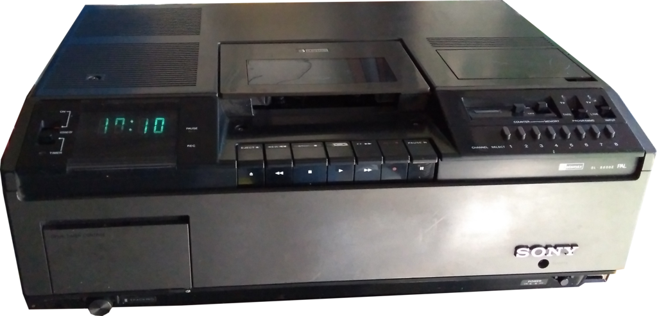
Sony v. Universal (aka Betamax)

Slide 82
Sony v. Universal (aka Betamax)
Is recording TV broadcasts infringing?
Were owners of Betamax machines infringing copyright when they used the machines to record TV broadcasts?
If so, was Sony liable for contributory infringement because they manufactured devices that were used for copyright infringement?
Did the movie industry need “protection from the savagery and ravages of this machine,” as Jack Valenti (then president of MPAA) claimed? https://cryptome.org/hrcw-hear.htm

Slide 83
Sony v. Universal (aka Betamax)
“Including” in Action
Time-shifting (i.e., recording works when they are broadcast, in order to privately watch them later) is mentioned nowhere in the copyright law, and yet…
SCOTUS declared unauthorized time-shifting to be a fair use!
https://supreme.justia.com/cases/federal/us/464/417/case.html

Slide 84
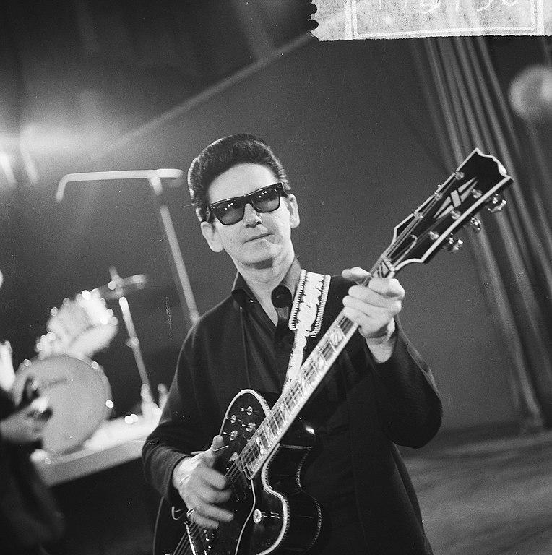
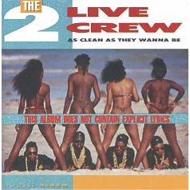
Campbell v. Acuff-Rose (2 Live Crew)

Slide 85
Campbell v. Acuff-Rose (2 Live Crew)
Did 2 Live Crew’s “Pretty Woman” infringe the copyright of Roy Orbison’s “Oh, Pretty Woman”?
Oh, Pretty Woman (Roy Orbison)
Pretty woman, walking down the street
Pretty woman, the kind I’d like to meet
Pretty woman
I don't believe you, you're not the truth
No one could look as good as you
Pretty Woman (2 Live Crew)
Pretty woman, walking down the street
Pretty woman, girl, girl you look so sweet
Pretty woman, you, you bring me down to that knee
Pretty woman, you make me wanna beg please
Oh, pretty woman

Slide 86
Campbell v. Acuff-Rose (2 Live Crew)
“Such As” in Action
Parody is mentioned nowhere in the copyright law, and yet…
SCOTUS ruled that parody, like other forms of comment and criticism, weighs in favor of fair use, even if it is commercial!
https://supreme.justia.com/cases/federal/us/510/569/case.html

Slide 87
Parody & the “Heart” of a Work
“[I]f quotation of the opening riff and the first line may be said to go to the ‘heart’ of the original, the heart is also what most readily conjures up the song for parody, and it is the heart at which parody takes aim. Copying does not become excessive in relation to parodic purpose merely because the portion taken was the original’s heart. If 2 Live Crew had copied a significantly less memorable part of the original, it is difficult to see how its parodic character would have come through.”
— SCOTUS 2 Live Crew Opinion (written by Justice David Souter)

Slide 88
Detour: The Turn toward Transformativeness
“I believe the answer to the question of justification turns primarily on whether, and to what extent, the challenged use is transformative. The use must be productive and must employ the quoted matter in a different manner or for a different purpose from the original. . . . [I]f the quoted matter is used as raw material, transformed in the creation of new information, new aesthetics, new insights and understandings — this is the very type of activity that the fair use doctrine intends to protect for the enrichment of society.”
— Judge Pierre N. Leval, “Toward a Fair Use Standard,” Harvard Law Review, vol. 103, no. 5, 1990

Slide 89
What’s Special about Parody?
Transformativeness!
“The first factor in a fair use enquiry is ‘the purpose and character of the use, including whether such use is of a commercial nature or is for nonprofit educational purposes.’ . . . The central purpose of this investigation is to see, in Justice Story’s words, whether the new work merely ‘supersede[s] the objects’ of the original creation . . . or instead adds something new, with a further purpose or different character, altering the first with new expression, meaning, or message; it asks, in other words, whether and to what extent the new work is ‘transformative.’”
— SCOTUS 2 Live Crew Opinion (written by Justice David Souter)

Slide 90
What’s Special about Parody?
Transformativeness!
“Although such transformative use is not absolutely necessary for a finding of fair use . . . the goal of copyright, to promote science and the arts, is generally furthered by the creation of transformative works. Such works thus lie at the heart of the fair use doctrine’s guarantee of breathing space within the confines of copyright, . . . and the more transformative the new work, the less will be the significance of other factors, like commercialism, that may weigh against a finding of fair use.”
— SCOTUS 2 Live Crew Opinion (written by Justice David Souter)

Slide 91
What’s Special about Digital Scholarship?
Transformativeness!
Many DH projects — specifically, those that use copyrighted works as data — are transformative.
Copying works into a database in order to computationally analyze them, without displaying or distributing them, is often referred to as “non-consumptive use.”
Non-consumptive use is highly transformative.

Slide 92
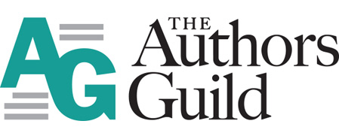
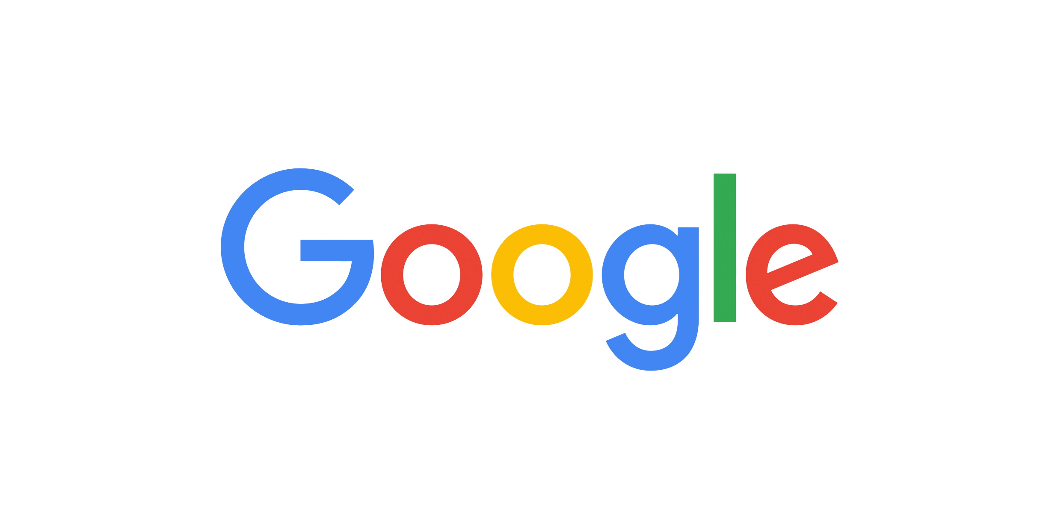

Slide 93
Authors Guild v. Google
Google Books = Transformative!
“Google’s making of a digital copy to provide a search function is a transformative use, which augments public knowledge by making available information about Plaintiff’s books without providing the public with a substantial substitute for matter protected by the Plaintiff’s copyright interests. . .”
— Second Circuit Court of Appeals, 2015 (written by Judge Leval) https://fairuse.stanford.edu/case/authors-guild-v-google-inc/

Slide 94
Authors Guild v. HathiTrust
“Quintessentially” Transformative!
“Turning to the first factor, we conclude that the creation of a full-text searchable database is a quintessentially transformative use. . . . [T]he result of a word search is different in purpose, character, expression, meaning, and message from the page (and the book) from which it is drawn. Indeed, we can discern little or no resemblance between the original text and the results of the [HathiTrust Digital Library] full‐text search.”
— Second Circuit Court of Appeals, 2013 (written by Judge Parker) https://www.documentcloud.org/documents/1184989-12-4547-opn.html

Slide 95
Digital Scholarship = Home Free?
No.
Not all uses of copyrighted works in digital scholarship are transformative.
Further, not all transformative uses are fair.

Slide 96
Digital Scholarship = Home Free?
No.
“The existence of any identifiable transformative objective does not, however, guarantee success in claiming fair use. . . . [E]xtensive takings may impinge on creative incentives. And the secondary user’s claim under the first factor is weakened to the extent that her takings exceed the asserted justification. The justification will likely be outweighed if the takings are excessive and other factors favor the copyright owner.”
— Judge Pierre N. Leval, “Toward a Fair Use Standard,” Harvard Law Review, vol. 103, no. 5, 1990

Slide 97
Limitations
“Items in copyright digitized for nonconsumptive uses should not be employed in other ways (e.g., to provide digital access for ordinary reading) without independent justification, either by a license from the rights holder or pursuant to a statutory exception. Search access to database materials should be limited to portions appropriate to the nonconsumptive research purpose.”
— Code of Best Practices in Fair Use for Academic and Research Libraries https://www.arl.org/focus-areas/copyright-ip/fair-use/code-of-best-practices

Slide 98
How open are copyrighted works for digital scholarship?
Somewhat, via fair use

Slide 99
How open are copyrighted works for digital scholarship?
Fairly fairly open

Slide 101
What if permission is sought and denied?
2 Live Crew sought permission from Acuff-Rose and were willing to pay a fee.
Acuff-Rose said no: “I am aware of the success enjoyed by ‘The 2 Live Crews’, but I must inform you that we cannot permit the use of a parody of ‘Oh, Pretty Woman.’” https://supreme.justia.com/cases/federal/us/510/569/#tab-opinion-1959465
2 Live Crew used “Oh, Pretty Woman” anyway.
What is the significance to the case of the request and denial?

Slide 102
Fair uses remain fair, even if permission is denied!
“[W]e reject Acuff-Rose's argument that 2 Live Crew's request for permission to use the original should be weighed against a finding of fair use. Even if good faith were central to fair use, 2 Live Crew's actions do not necessarily suggest that they believed their version was not fair use; the offer may simply have been made in a good-faith effort to avoid this litigation. If the use is otherwise fair, then no permission need be sought or granted. Thus, being denied permission to use a work does not weigh against a finding of fair use.”
— SCOTUS 2 Live Crew Opinion (written by Justice David Souter)

Slide 103
Extralegal Considerations
Proceeding without permission could negatively affect a researcher’s ongoing relationship with (or desired future relationship with) their research subject.
Researchers may want to factor such considerations into their decision-making.

Slide 104
Fair use is a right. Use it.
“. . . the right of fair use as provided by section 107 . . .”
— 17 U.S. Code § 108 https://www.law.cornell.edu/uscode/text/17/108

Slide 105
“Fair use is not civil disobedience.”
— James G. Neal https://doi.org/10.7916/D88G8VWC

Slide 106
Fair Use Checklist
Is My Specific Use Fair?
Fair Use Checklist https://copyright.columbia.edu/basics/fair-use/fair-use-checklist.html
Does not provide yes/no answer but helps you evaluate your use, and can provide documentation of your decision-making process.

Slide 107
Go Forth & Transform (Thoughtfully, Carefully)!

Slide 108
Credits
Betamax photo by Dr.marioli (CC-0): https://commons.wikimedia.org/wiki/File:Sony_Betamax_Sl-8000E_Videorekorder_1979.png
Roy Orbison photo by Jack de Nijs (CC-0): http://proxy.handle.net/10648/aa9b233e-d0b4-102d-bcf8-003048976d84
As Clean As They Wanna Be album cover likely © Luke Records and/or graphic designers https://en.wikipedia.org/wiki/File:Ascleanastheywannabe_cover.jpg

